Slide 1
Measuring and valuing health in children for HTA
Professor Simon Dixon,
School of Health and Related Research (ScHARR), University of Sheffield

Slide 2
Outline
Introduction
Existing preference based measures
Current practice…Decision Support Unit (DSU) review
New NICE methods?
Conclusions
Other issues to consider…

Slide 3
Introduction
Generating QALYs for children has several theoretical, technical and practical problems
Health may have different domains than in adults
For the same domains, the descriptions need to be different
Who’s values should be used? Children or adults?
How do you get child values when the valuation tasks are complex?
Do you need instruments for different stages of childhood?
What do you do with the transition from child to adult in cost-effectiveness models?

Slide 4
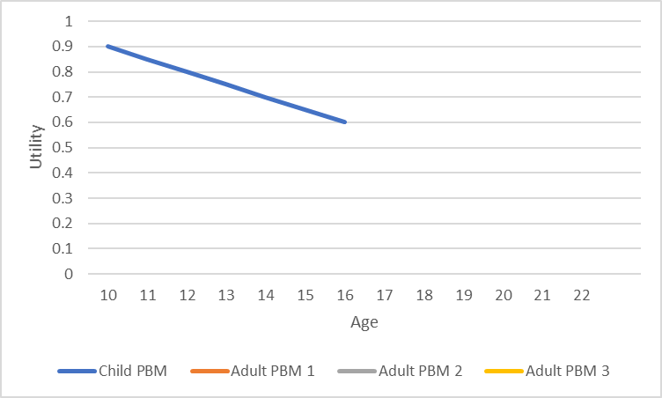
Imagine a children's PBM that describes a reduction in health over time associated with disease progression…..

Slide 5
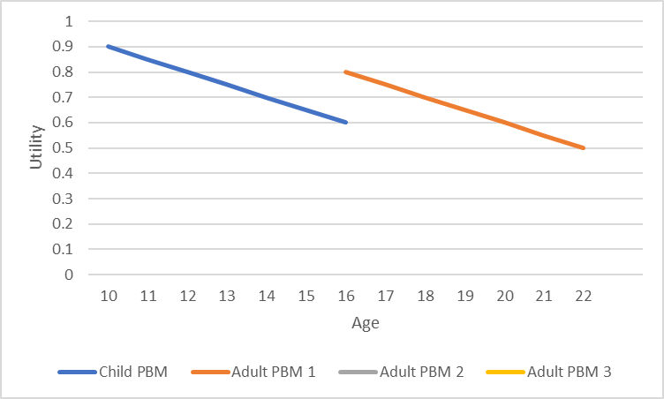
At 16, they switch to an adult PBM (with different domains and tariff)…

Slide 6
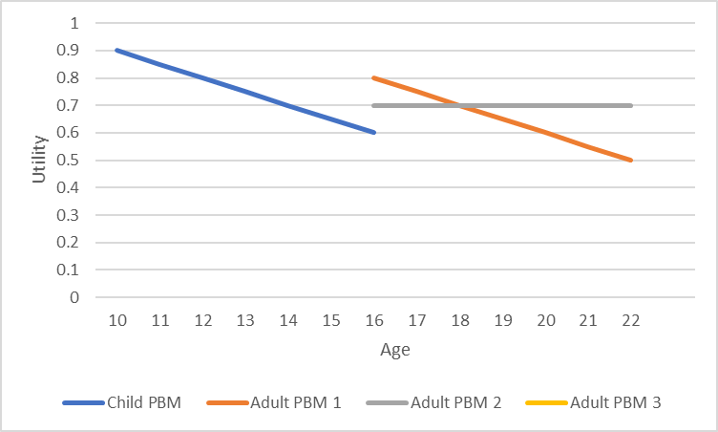
What if the adult PBM is less sensitive….?

Slide 7
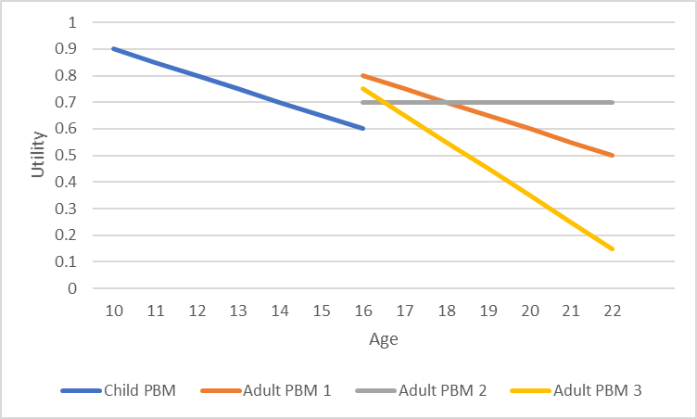
What if the adult PBM is more sensitive….?

Slide 8
Existing measures: EQ-5D-Y
EQ-5D-Y based on an adult measure
Domains are mobility (walking about), looking after myself, doing usual activities, having pain or discomfort, and feeling worried, sad or unhappy
Value set is the same as the EQ-5D-3L
Ages 4-7 proxy EQ-5D-Y, 8-11 self-completed, 12-15 EQ-5D-Y or EQ-5D (adult), 16 and over EQ-5D (adult)
EQ-5D-5L-Y and a children’s tariff are in development; tariff will be adult values taking the perspective of a 10-year old child

Slide 9
Existing measures: HUI-2
HUI-2 developed for use in children and adults but domains and values produced by adults
Domains are sensation, mobility, emotion, cognition, self-care, pain and fertility
Value set is based on adult valuations, but respondents asked to take the perspective of a 10-year old child
Ages 5-12 proxy, over 12 self-completed
HUI-3 for use in adults…different instrument completely but valued in a similar way

Slide 10
Existing measures: CHU-9D
CHU-9D descriptive system is based on interviews with children
Domains are worry, sadness, pain, tiredness, annoyance, school, sleep, daily routine and activities
UK value set based on adults, Australian value set based on the preferences of adolescents aged 11 to 17 years
Developed for 7-11 year olds, with proxy and self-completion, use in ages 4-17 has been successful
UK adolescent valuation is being planned

Slide 11
Thorrington and Eames, 2015

Slide 12
Kwon et al, 2018
Review and meta-analysis, explanatory analysis and database
272 papers, 1073 reporting mean values
Dummy variable | HUI3 coefficient (p-value) | Rescaled VAS coefficient (p-value)
Jointly assessed | -0.055 (<0.001) | +0.012 (0.807)
Proxy by parents | +0.041 (0.001) | +0.074 (0.005)
Proxy by caregivers | -0.053 (<0.001) | -0.030 (0.540)
Proxy by physicians | +0.090 (0.054) | +0.132 (0.001)
Samples with minimum age greater than 12 | -0.060 (0.033) | -0.055 (0.026)

Slide 13
Kwon et al, 2018
Review and meta-analysis, explanatory analysis and database
272 papers, 1073 reporting mean values
Dummy variable | HUI3 coefficient (p-value) | Rescaled VAS coefficient (p-value)
Jointly assessed | -0.055 (<0.001) | +0.012 (0.807)
Proxy by parents | +0.041 (0.001) | +0.074 (0.005)
Proxy by caregivers | -0.053 (<0.001) | -0.030 (0.540)
Proxy by physicians | +0.090 (0.054) | +0.132 (0.001)
Samples with minimum age greater than 12 | -0.060 (0.033) | -0.055 (0.026)

Slide 14
Current practice
NICE methods
“When necessary, consideration should be given to …preference-based measures…that have been designed specifically for use in children”
NICE Decision Support Unit (DSU) identified 31 Technology Appraisals over the last 20 years that have included indications covering children
Huge variety in the methods used to generate utility values
Makes it difficult to produce consistent decision making
Most methods used have serious flaws
Parental quality of life impacts sometime included (e.g. Bexsero)

Slide 15
Review results
Most appraisals included multiple methods which shows that researchers are uncertain about the best approach
Only 3 appraisals used HUI2 and none used the CHU-9D
Mapping used in 8 appraisals…all mapped to adult tariffs…poorly
One mapping was non-statistical…speech recognition scores were matched to levels in the speech domain of the HUI3
A non-preference based measure was used in one study and transformed onto a 0-1 scale

Slide 16
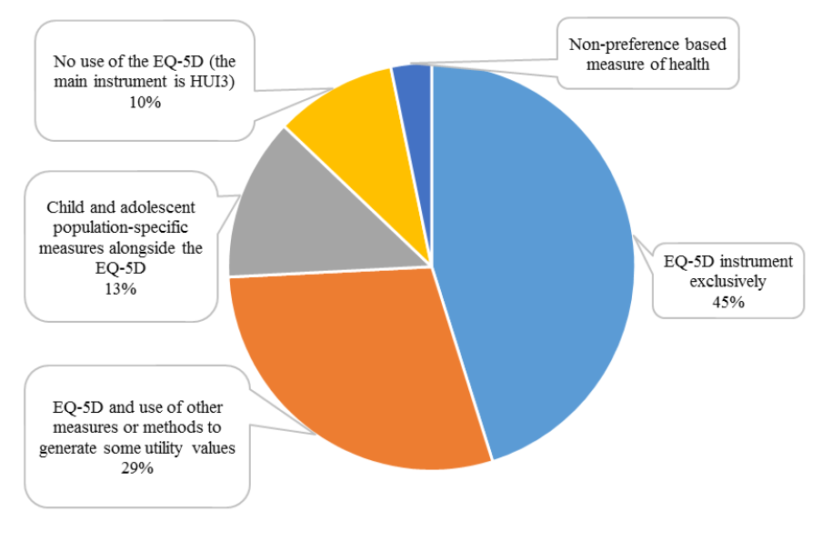
Which instruments were used?

Slide 17
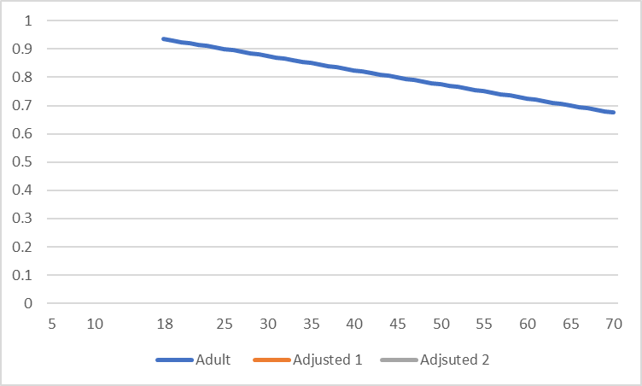
Other issues
Age adjustment
In adult populations, utility decreases with age and this is incorporated in cost-effectiveness models…functioning decrease and co-morbidities increase
Does this make sense for ages under 18? Does functioning increase and co-morbidities decrease compared to your adults?

Slide 18
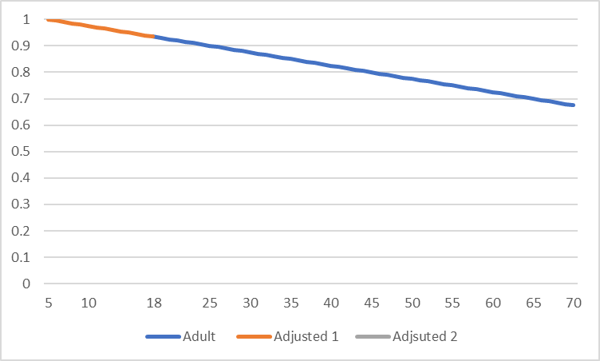
Age adjustment
But, there are no data on respondents under the age of 18
Extrapolation is ‘out of sample’

Slide 19
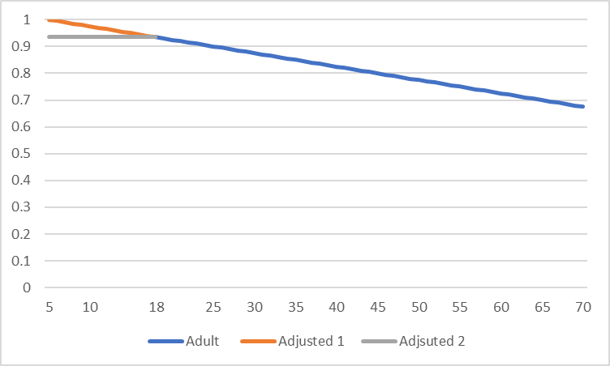
Age adjustment
In adult populations, utility decreases with age and this is incorporated in cost-effectiveness models…functioning decrease and co-morbidities increase
Does this make sense for ages under 18? Does functioning increase and co-morbidities decrease compared to your adults?

Slide 20
Other issues
General population surveys have not been undertaken in the UK, so general population values for children don’t exist for EQ-5D, HUI or CHU-9D
Various methods were used in the NICE appraisals which produced values varying from 0.85 to 1
Transition from child to adult modelled in 16 appraisals, but only two included changes in values
7 appraisals were for drugs with adult and child licenses, but only adults were modelled
8 modelled children up to age 18, but not beyond
Transition between proxy and self-reported health
For example, HUI2, ages 5-12 proxy, over 12, self-completed

Slide 21
New NICE methods?
NICE methods are currently being reviewed
New guidance is likely to be stricter but remain flexible
No recommended preference based measure
Proof of face validity required…patient involvement
Proof of psychometric validity
Clear justification of methods
Nothing specific on parental QoL

Slide 22
Conclusions
Valuation of child health is still a developing research area
Theoretical problems…technical problems…practical problems
Developers face trade-offs
Using the EQ-5D-5Y reduces transition problems, but are the domains and values valid?
Using the CHU-9D improves the validity of the descriptive system, but introduces age and respondent transition problems
Neither have general population values or child values (for the UK)
Impact of children’s health problems on parental and family health also needs consideration

Slide 23
Other issues
The problems are largely ignored by reimbursement bodies as they rarely say ‘no’ to drugs in paediatric populations….NICE changed the discount rate to recommend one paediatric drug!
Are cost-effectiveness and QALYs important for paediatric populations?
With a very large equity weight for children, any health gain could be cost-effective (at current drug pricing)
But, there is an opportunity cost for adult patients from an increasing child health budget, so we need to know the equity weight and the health values for children
And, how do you allocate resources within the child health budget?

Slide 24
References and reading
Hill H, Rowen D, et al. A review of the methods used to estimate and model utility values in NICE Technology Appraisals for paediatric populations. Sheffield: NICE DSU, 2019.
Rowen D, et al. Review of Valuation Methods of Preference-Based Measures of Health for Economic Evaluation in Child and Adolescent Populations: Where are We Now and Where are We Going? Pharmacoeconomics 2020;38(4):325-340.
Thorrington D, Eames K. Measuring Health Utilities in Children and Adolescents: A Systematic Review of the Literature. PLOS One; August 14, 2015
Kwon J, et al. A Systematic Review and Meta-analysis of Childhood Health Utilities. Medical Decision Making 2018, Vol. 38(3) 277–305

Slide 25
To Discover And Understand.

