Slide 1

UK-China Health and Economy Partnership Workshop
Introduction and comparison of
MAU instruments
Shunping Li Professor
Center for Health Preference Research, Shandong University
NHC Key Laboratory of Health Economics and Policy Research (Shandong University)
School of Public Health, Shandong University

Slide 2

Health state utility
Decision: Medical insurance, Medical treatment, Medicine
…
Why
Utility
QALYs
CUA
HTA
What
Cost
How

Slide 3
Health state utility
Health state utility
Preference
0~1
Why
What
How

Slide 4
Health state utility
TTO
SG
Direct measure-ment
Indirect measure-ment
Why
What
MAUI
Mapping
How

Slide 5
MAUI
Generic Preference-Based Measures
Adult
Children and Adolescents
Condition-Specific Preference-Based Measures

Slide 6
MAUI
SF-36
HUI2
HUI3
15D
AQOL-8D
2005
2010
2015
EQ-5D
SF-6D(36)
PROMIS-Pr

Slide 7
MAUI for Children and Adolescents
AHUM (Adolescent Health Utility Measure)
CHU9D
EQ-5D-Y
AQoL-6D Adolescent
17D
16D
HUI3
HUI2
QWB
UK
2000s
Australia
Finland
1990s
Canada
1970s
USA

Slide 8
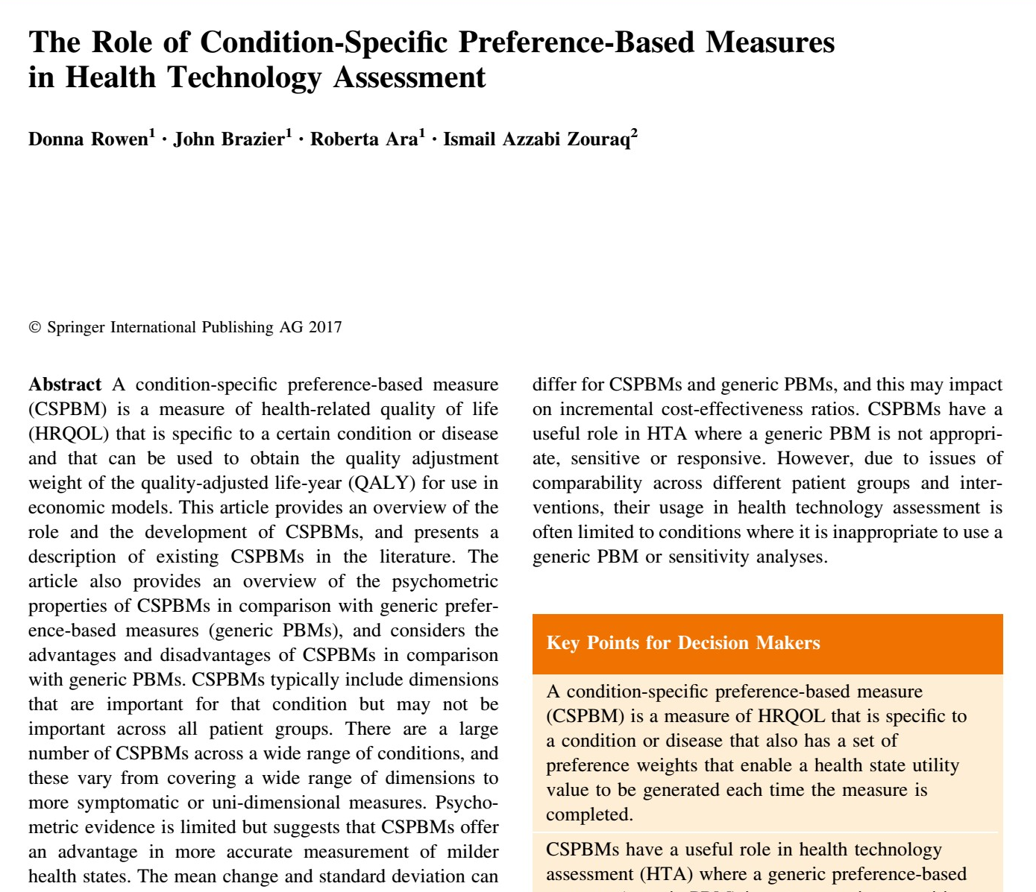
Condition-Specific Preference-Based Measures
29 disease conditions,
36 Condition-Specific Preference-Based Measures

Slide 9
QWB
QWB (Quality of Well-being Scale) was first proposed by Kaplan et al in 1976.
In 1997, Kaplan et al. formed a QWB self-test scale (QWB-SA), including 5 parts: symptoms/complex health problems, self-care, mobility, physical activity, and daily activities/social activities, and completed the questionnaire for about 10 minutes.
15D
EQ-5D
HUI
SF-6D
AQOL
https://hoap.ucsd.edu/qwb-info/
PROMIS
WANG Xue-wen, LI Shun-ping*, LI Wen-di, et al. Introduction of QWB Instrument Application Chinese Health Economics. 2019

Slide 10
The 15D was developed by Professor Sintonen‘s team in Finland and went through three stages of development, namely the 12D、15D.1 and 15D.2. It was developed into 15D.1 version in 1989 and further revised in 1993 to form the current 15D scale.
The scale consists of 15 dimensions, including flexibility, vision, hearing, breathing, sleep, eating, speaking, excretion, daily activities, brain function, physical discomfort and symptoms, depression, stress, vitality and sexual behavior. Each dimension contains five levels of measurement.
QWB
15D
EQ-5D
HUI
SF-6D
AQOL
PROMIS
http://www.15d-instrument.net/15d/
WANG Xue-wen, LI Shun-ping*, CHEN Gang. Introduction of 15D Instrument Application. Chinese Health Economics. 2018( 2):5-7.

Slide 11
The EQ-5D scale was developed by the EuroQoL Group in the 1980s and consists of a self-rating scale and a visual simulation scale.
The self-rating scale includes five dimensions of action, self-care, daily activities, pain/discomfort and anxiety/depression, each of which contains five levels.
In 2009, EQ-5D-3L was developed into EQ-5D-5L scale.
QWB
15D
EQ-5D
HUI
SF-6D
AQOL
https://euroqol.org/
1. Li Minghui, Ronan. Introduction to the Chinese version of European Five dimensional Health Scale (EQ-5D). CHINA JOURNAL OF PHARMACEUTICAL ECONOMICS. 2009(1):49-57.
PROMIS
2. Mathieu Janssen, Gouke Bonsel, Nan Luo. Is EQ-5D-5L Better Than EQ-5D-3L? A Head-to-Head Comparison of Descriptive Systems and Value Sets from Seven Countries. PhsrmocoEconomics(2018)36:675-697.

Slide 12
QWB
The HUI (Health Utilities Index) was developed by Torrance et al., Canada, in 1982. It is currently registered and authorized by Health Utilities Inc.
HUI consists of three scales: HUI1, HUI2 and HUI3. Health status of the HUI3 Scale includes eight dimensions: visual, auditory, verbal, walking, flexibility, emotional, cognitive function and pain sensation. Each dimension has five to six levels and can describe 97,200 specific health states.
15D
EQ-5D
HUI
SF-6D
AQOL
PROMIS
www.healthutilities.com
ZHANG Lu-jia, LI Shun-ping*, CHEN Gang. Introduction of Applications for HUI Instruments. China Journal Of Pharmaceutical Economics. 2019

Slide 13
The SF-6D was first developed on the basis of THE SF-36 by John Brazier in 1998.Divided into six dimensions: physical function, role limitation, social function, pain, mental health and vitality; each dimension has 2 to 6 levels;
In 2002, the role limitation dimension was increased to 4 levels, which can describe 18,000 health states;
In 2004, John Brazier developed the SF-6D (SF-12). Compared with the SF-6D (SF-36) scale, the dimensions of role restriction, social function, mental health and vitality remained unchanged, the physical function dimension was reduced to 3 levels, and the first level of the pain dimension (no pain) was deleted to describe 7,500 health states.
QWB
15D
EQ-5D
HUI
SF-6D
AQOL
PROMIS
http://www.qualitymetric.com/products/license/
LIU Xiao-han,LI Shun-ping*, CHEN Gang. A Comparison on the Short Form Six-dimension (SF-6D) Utility Tariff in Different Countries and Regions. Chinese Health Economics. 2019

Slide 14
The AQoL (Assessment of Quality of Life) series of scales was developed by the Australian research team of Professor Richardson to measure small differences in health status in order to improve the sensitivity of health utility measures.
Aqol-8d is the development and extension of AQOL-4D and AQOL-6D. The concept of higher dimensions (physical and psychosocial dimensions) was first proposed. The 8D scale has a total of 35 items in 8 dimensions.
QWB
15D
EQ-5D
HUI
SF-6D
AQOL
PROMIS
http://www.aqol.com.au/
GAO Zhong-chun, LI Shun-ping, CHEN Gang. Introduction of Applications for AQoL Instruments. Chinese Health Economics. 2018
Notes:
高级维度，包括生理维度和心理-社会维度

Slide 15
Patient reported outcome measurement information system (PROMIS) is a measurement tool that collects self-reported information about patients' physical, psychological, and social status. It was started in 2004 by the National Institutes of Health (NIH). The latest PROMIS theoretical framework has four levels.
PROMIS-Pr is a generic preference-based score ranging from 0 to 1. It is based on a total score in seven areas: cognition, depression, fatigue, pain disturbances, physical function, sleep disorders and the ability to participate in social roles and activities. The subjects completed the item of PROMIS-29 V2.0 and Cognitive Function-abilities V2.0, and the utility score could be calculated.
QWB
15D
EQ-5D
HUI
SF-6D
AQOL
PROMIS
http://www.healthmeasures.net/explore-measurement-systems/promis
Dewitt, Barry, et al. “Estimation of a Preference-Based Summary Score for the Patient-Reported Outcomes Measurement Information System: The PROMIS®-Preference (PROPr) Scoring System.” Medical Decision Making, vol. 38, no. 6, Aug. 2018, pp. 683–698
Notes:
四个等级：第一等级将健康分为三部分：生理、心理和社会健康；第二等级将这三部分进一步划分：生理健康（症状、功能）、心理健康（影响、行为、认知）、社会健康（人际关系、功能）；第三等级继续划分领域（domain）：如将症状划分为疼痛、疲乏、消化道症状和哮喘影响。第四等级为亚领域（sub-domain），如疼痛划分为疼痛表现、疼痛影响、疼痛强度和性质。

Slide 16
Abbreviation | EQ-5D | SF-6D（SF-36） | SF-6D（SF-12） | HUI3 | QWB-SA | 15D | AQoL-8D
Full name | Originally EuroQol (RS and TTO versions) | Short form 6D | Short form 6D | Health Utility Index, Mark 3 | Quality of Wellbeing Index | 15-dimension instrument | Assessment of Quality of Life (8D)
country | England | England | England | Canada | America | Finland | Australia
Institution | EuroQol Group | University of Sheffield | University of Sheffield | McMaster University | University of California at San Diego | University of Kuopio | Monash University
Time | 1990 | 2002 | 2004 | 1998 | 1997 | 1994 | 2009
Dimension | 5 | 6 | 6 | 8 | 4 | 15 | 8
Item | 5 | 6 | 6 | 8 | 77 | 15 | 35
Level | 3/5 | 4-6 | 3-5 | 5-6 | 3-5 | 5 | 4-6
Healthy state | 245/3125 | 18000 | 7500 | 972000 | 945 | 3.1×10¹⁰ | 2.4×10²³

Slide 17
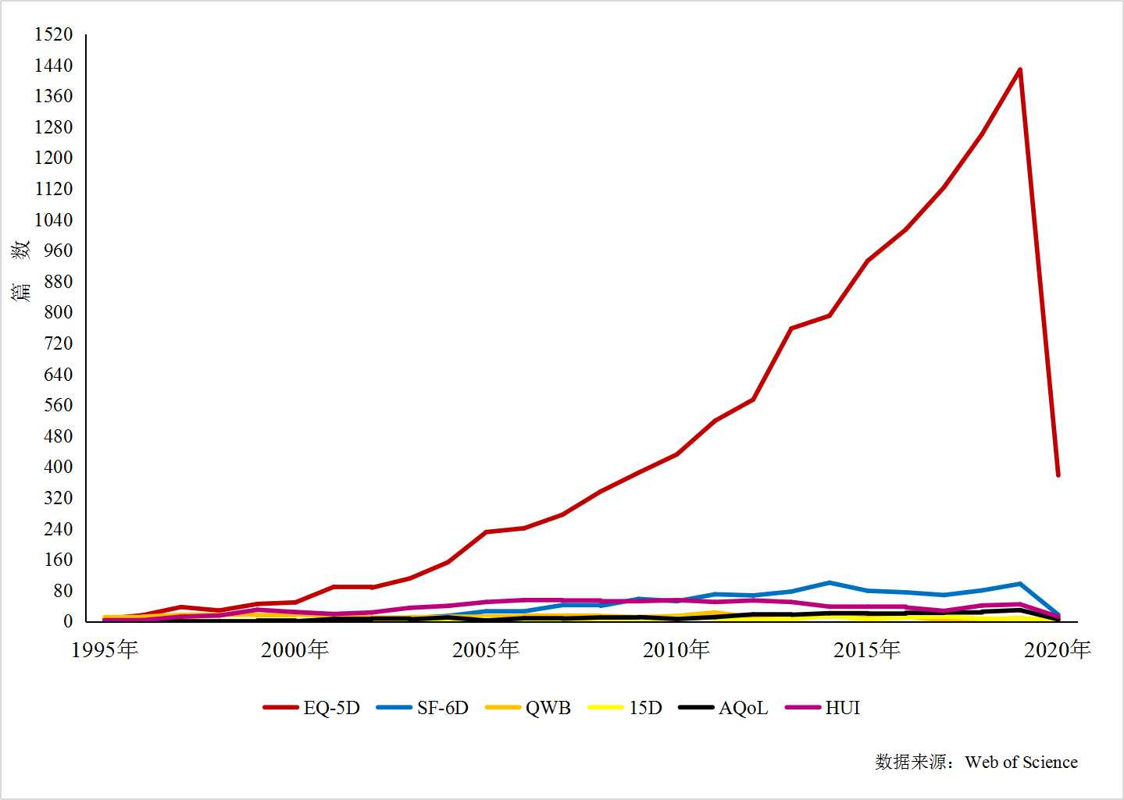

Slide 18
In 2005~2010
Richardson J, Iezzi A, Khan MA. Why do multi-attribute utility instruments produce different utilities: the relative importance of the descriptive systems, scale and 'micro-utility' effects. Qual Life Res. Aug 2015;24(8):2045-2053.

Slide 19
PE guidelines that recommend from 35 countries or regions
Prefer/encourage | Country/region | Quantity
Single（EQ-5D） | Belgium、Bulgaria、Columbia、Croatia、Czech Republic、England、The Netherlands、New Zealand、Norway、Poland、Portugal、Scotland、Thailand、Chile、Sweden | 15
Two or More | Australia、Brazil、Canada、Egypt、Hungary、Iran、Ireland、France、Japan、Malaysia、Singapore、Slovak republic、South Korea、China（Taiwan）、China | 15
Not recommended | Cuba、Finland、Israel、Mexico、Slovenia | 5
[1]KENNEDY-MARTIN M, SLAAP B, HERDMAN M, et al. Which multi-attribute utility instruments are recommended for use in cost-utility analysis? A review of national health technology assessment (HTA) guidelines [J]. The European journal of health economics : HEPAC : health economics in prevention and care, 2020, 21(8): 1245-57.
[2]LIU Guo-en. China Guidelines for Pharmacoeconomic Evaluations[M]. Beijing：China Market Press，2020.

Slide 20
Comparison of MAUI
1. LI S P, WANG M, LIU L, et al. Which approach is better in eliciting health state utilities from breast cancer patients? Evidence from mainland China [J]. European Journal of Cancer Care, 2019, 28(2).
2. LI SP, ZHANG L J, WANG X W, et al. A systematic review of general multi-attribute utility (MAU) instrument comparison studies for adults.(unpublished)

Slide 21

Thanks
Tel：131 8893 4998
E-mail : lishunping@sdu.edu.cn
Notes:
随着计算机技术发展及印刷技术进步丰富

