Slide 1
Cost-effectiveness of diagnostic strategies for suspected acute coronary syndrome (ACS)
Dr. Praveen Thokala,
The University of Sheffield

Slide 2
Contents
Project overview
Conceptual modelling
Data for the model
Model Results
NICE appraisals
Discussion

Slide 3
Acute Coronary Syndrome
ACS typically occurs when a patient with CAD develops obstruction of their heart arteries.
Can lead to myocardial infarction (MI), heart failure, arrhythmia, cardiac arrest and death.
ACS usually presents as chest pain and must be differentiated from other common causes
Suspected ACS represents a substantial health care problem; responsible for around 700,000 emergency department attendances in England and Wales = almost 1 million bed-days

Slide 4
Investigating suspected ACS
Diagnosis is based upon an elevation of biomarkers (usually troponin) above the 99th percentile of the upper reference limit
However, troponin does not achieve optimal sensitivity for MI until several hours after the symptoms so guidelines recommend delaying sampling until 10-12 hours after symptom onset

Slide 5
Diagnosing suspected ACS
Delaying blood testing until 10-12 hours after symptom onset is inconvenient for patients and often incurs additional health care costs associated with hospital admission and/or observation
Earlier diagnosis using combinations of biomarkers and using newer, more sensitive troponin assays.
Need to estimate whether these new diagnostic technologies can be cost-effective

Slide 6
Hospital settings
Clinical decision unit (CDU) scenario, in which medical staff were available 24 hours a day
General ward scenario, in which medical staff were only available at twice daily ward rounds (e.g. 9:00am and 6:00pm) to make disposition decisions.
Cost-effectiveness could be different in these settings

Slide 7
Conceptual modelling

Slide 8
Conceptual modelling: Iterative process
Systematic
reviewing
Input from
clinicians
Conceptual
modelling
Data extraction

Slide 9
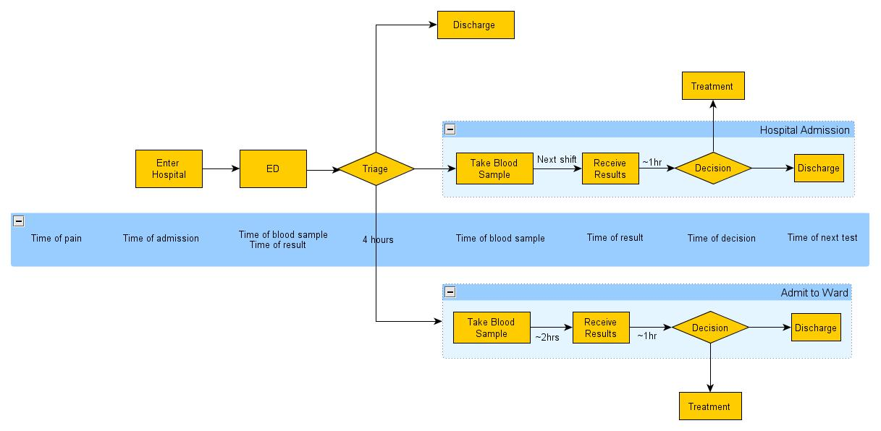
Key events in the model

Slide 10
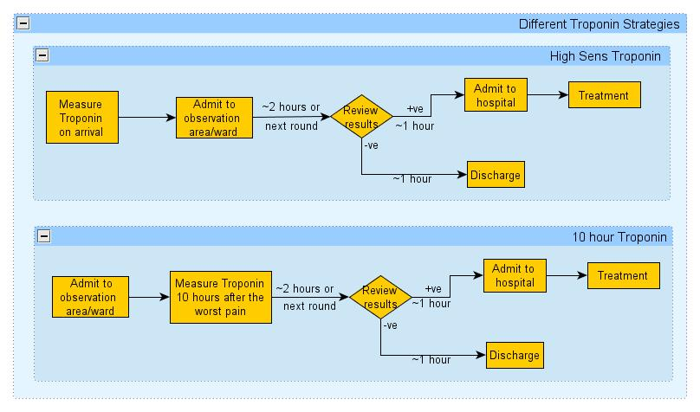
Troponin strategies

Slide 11
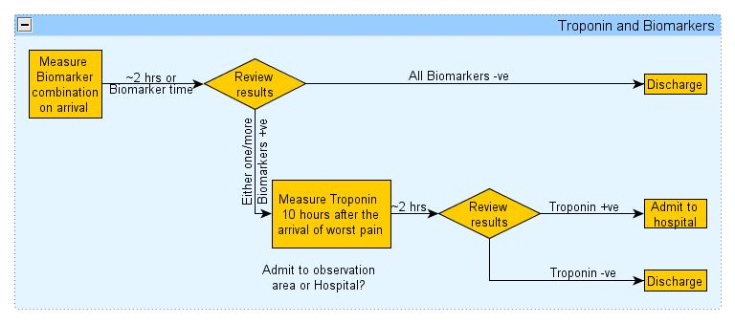
Biomarker strategies

Slide 12
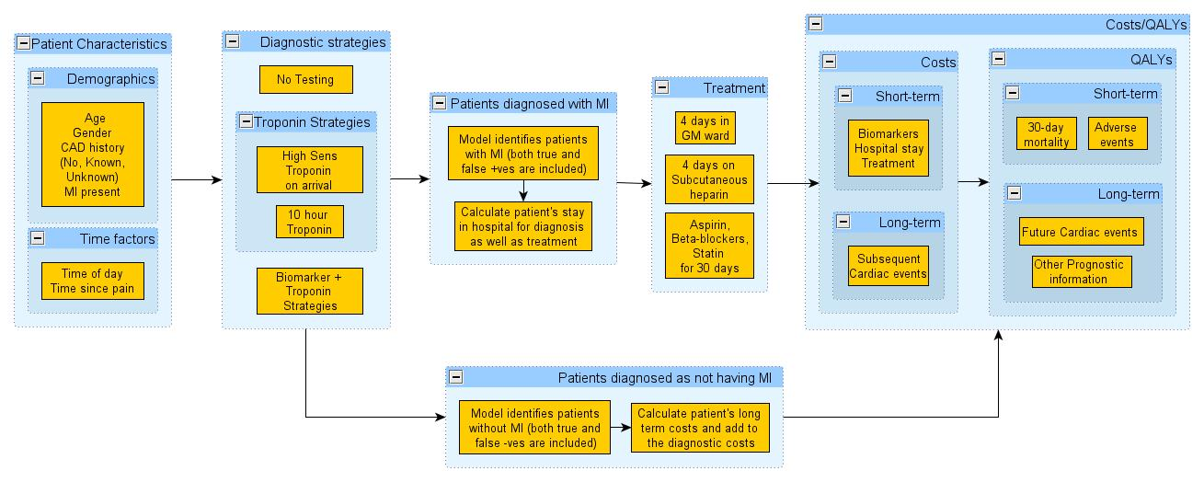
Model Overview

Slide 13
Data for the model

Slide 14
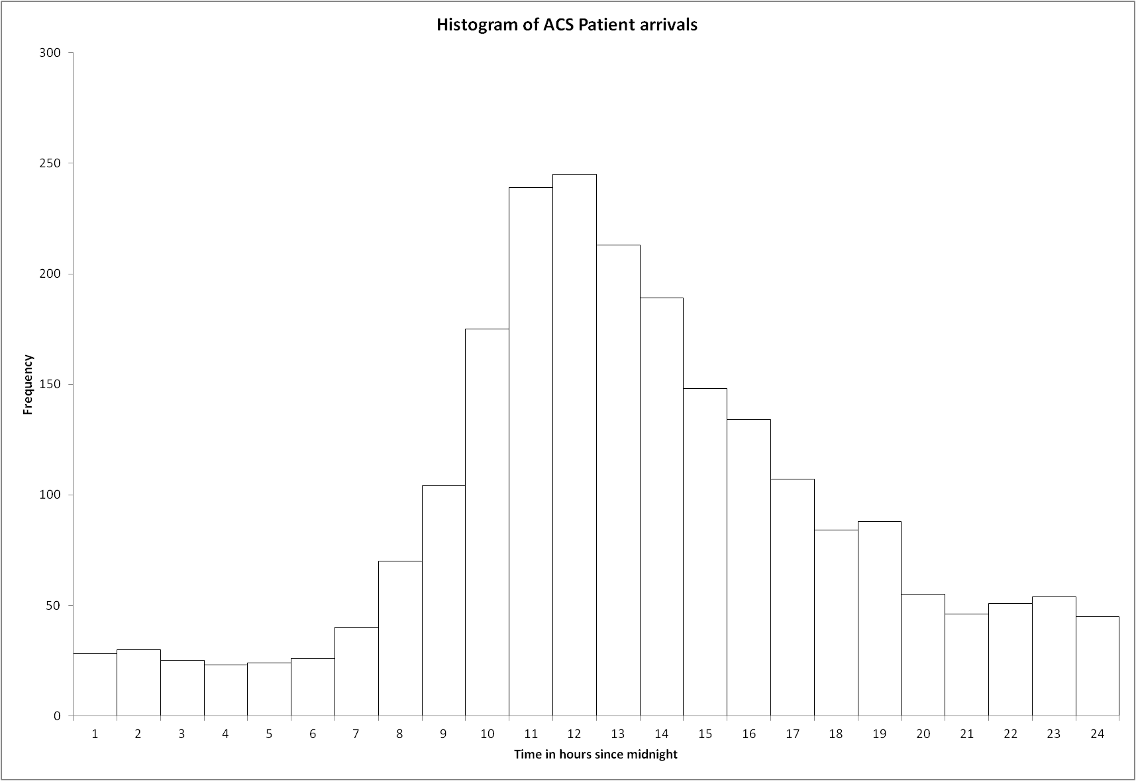
Patient Arrival data

Slide 15
Diagnostic accuracy
Strategy | Sensitivity | Specificity | Source
Discharge without testing or treatment | 0 | 1 | Theoretical
Ten hour troponin | 1 | 1 | Theoretical
Presentation standard troponin T using 10% CV threshold (0.03 µg/L) | 0.74 (0.35-0.94) | 0.96 (0.76-0.99) | Meta-analysis
Presentation standard troponin T using 99th centile threshold (0.01 µg/L) | 0.80 (0.33-0.97) | 0.91 (0.53-0.99) | Meta-analysis
Presentation high sensitivity troponin T using 99th centile threshold (0.014 µg/L) | 0.96 (0.27-1.0) | 0.72 (0.03-0.99) | Meta-analysis

Slide 16
Model parameters
Probabilities of death and non-fatal MI
Death, treated MI | 11% | n/N = 9/80 | Mills et al [11]
Death, untreated MI | 21% | n/N = 19/90 | Mills et al [11]
Reinfarction, treated MI | 11% | n/N = 9/80 | Mills et al [11]
Reinfarction, untreated MI | 29% | n/N = 26/90 | Mills et al [11]
Costs of tests, hospital stay and treatment Distribution Source
Treatment of MI | £3587 | Uniform (3000,4000) | NHS reference costs [16]
Hospital stay (per hour) | £22 | Uniform (20,30) | NHS reference costs [16]
Troponin testing (per test) | £20 | Uniform (18,25) | Goodacre et al [8]

Slide 17
Data on long term outcomes
Age (years) | Cost (£) | QALYs | QALYs with reinfarction
30-44 | 4012.5 | 12.20 | 9.76
45-54 | 3115 | 9.47 | 7.58
55-64 | 2215 | 6.73 | 5.39
65-74 | 1530 | 4.65 | 3.72
>75 | 800 | 2.43 | 1.95

Slide 18
Simulation Model

Slide 19
Results - CDU setting
 | Total Costs | Total QALYs | ICER
No Testing | 534,609 (525,085, 544,133) | 25,919.4 (25879.4, 25958.6) | -
Troponin I using 99th centile¹ + 10 hr Trop I - CDU | 1,268,223 (1,252,965, 1,283,481) | 26051.36 (26013.1, 26089.6) | £5,558/QALY
10 hour Troponin - CDU | 1,652,737 (1,636,329, 1,669,145) | 26065.47 (26026.2, 26104.7) | £27,465/QALY

Slide 20
Results - Ward setting
 | Total Costs | Total QALYs | ICER
No Testing | 534,609 (525,085, 544,133) | 25,919.4 (25879.4, 25958,6) | -
Troponin I using 99th centile¹ + 10 hr Trop I - Ward | 1,307,827 (1,292,017 1,323,637) | 26,053.04 (26014.5, 26091.6) | £5,859/QALY
10 hour Troponin - Ward | 2,027,916 (2,011,533 2,044,298) | 26,065.47 (26026.2, 26104.7) | £57,932/QALY

Slide 21
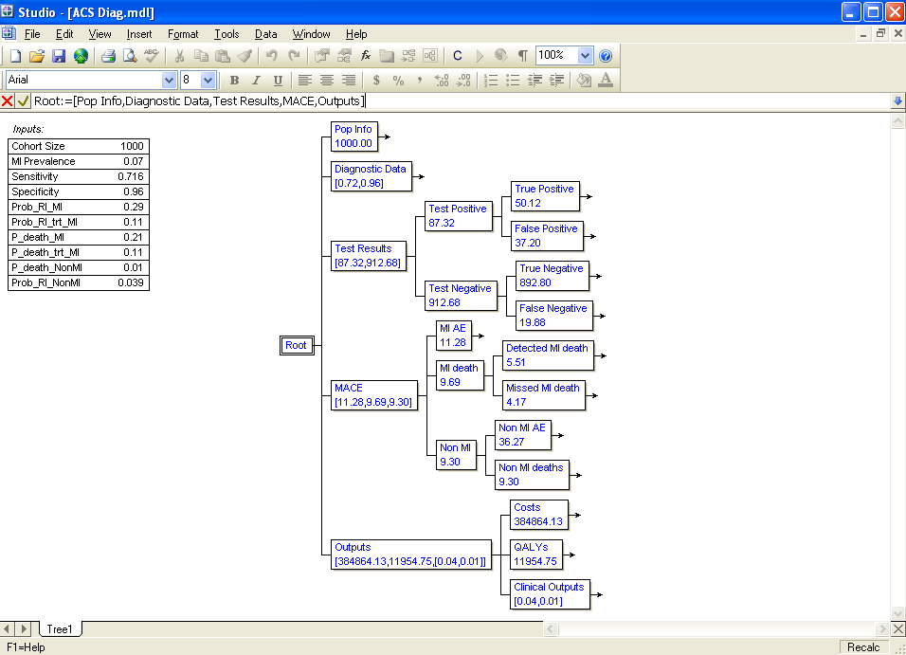
Model Validation

Slide 22
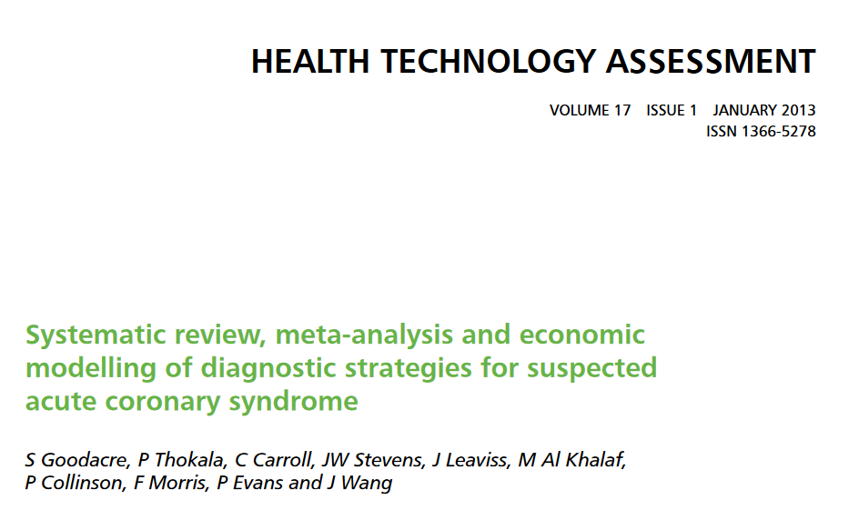
Our HTA Report

Slide 23
Our recommendations
10-hour Troponin is not a cost-effective use of NHS resources in most settings (the only exception is the CDU)
In these settings, early biomarkers should be used in combination with the 10-hour Troponin to ensure quick discharge of the patients
NIHR HTA programme does not have the mandatory power

Slide 24
NICE DAR project
NICE DAR (diagnostics assessment report) project on exactly the same topic
More focussed analysis – tight scope (e.g. only three biomarkers considered, only the CDU setting considered, etc)
Every assumption needs to be justified – under scrutiny by the manufacturers
NICE appraisal committee meeting & their decision based on the finished report

Slide 25
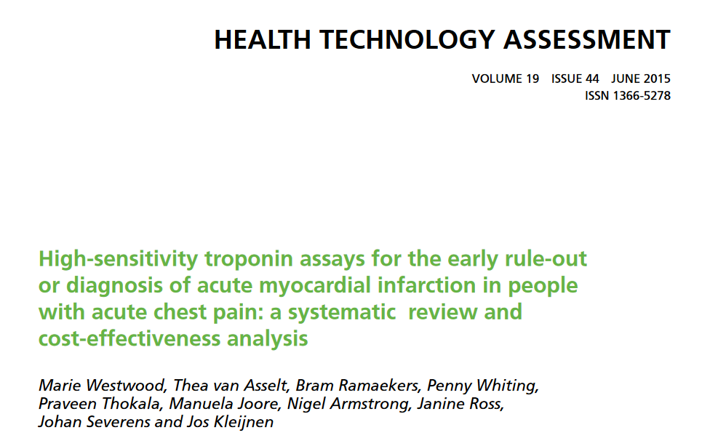
NICE Diagnostic Report

Slide 26
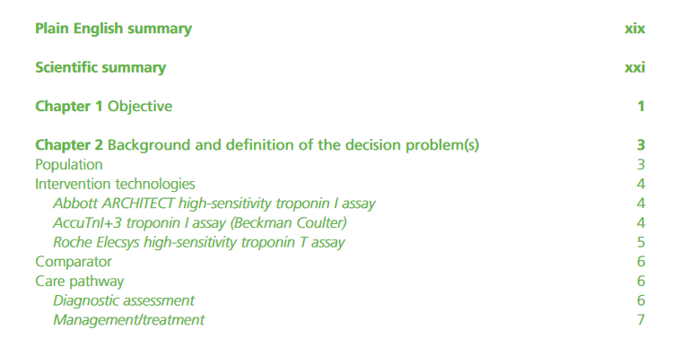
Three diagnostic technologies (in 2015)

Slide 27
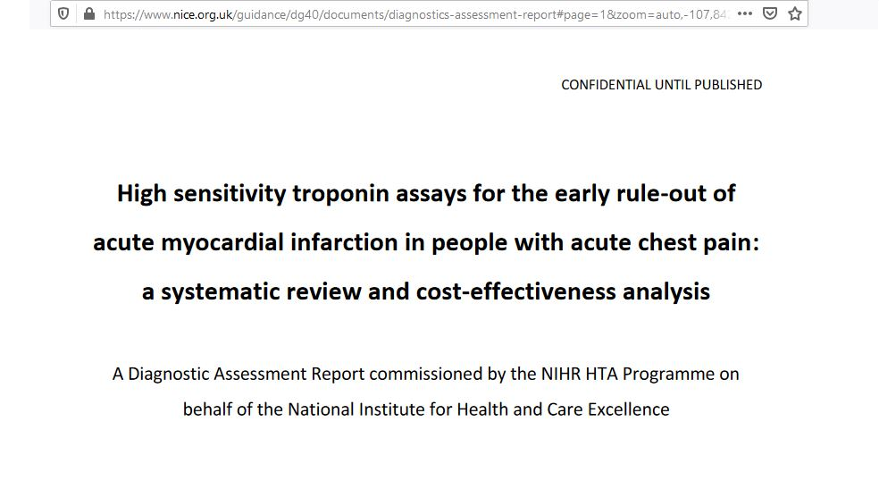
Updated NICE Report

Slide 28
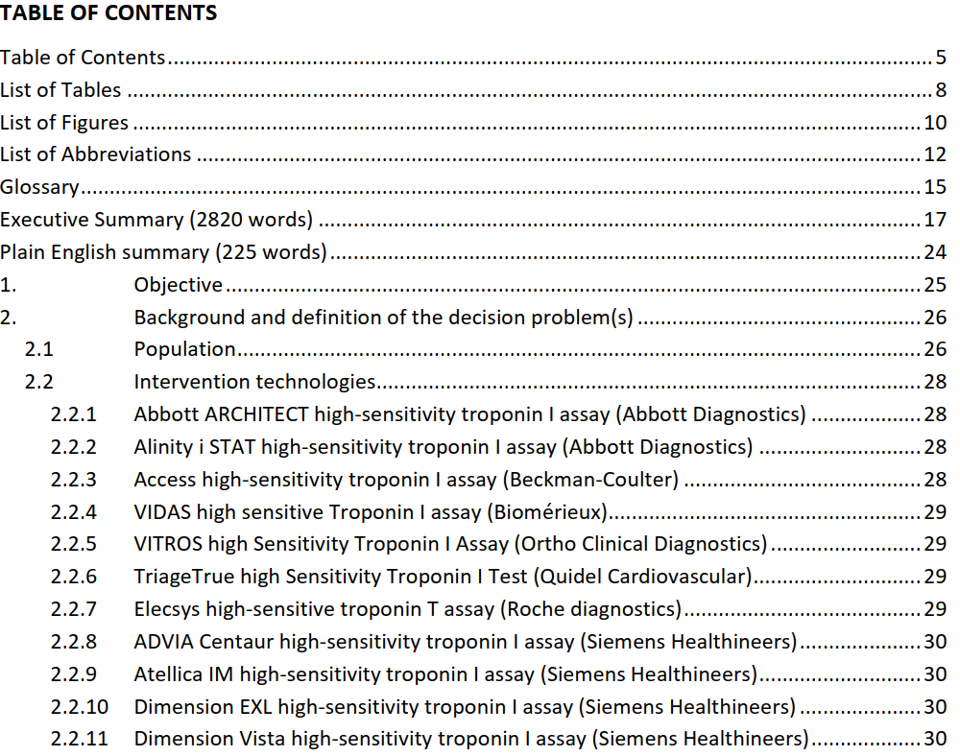
More technologies (in 2020)

Slide 29
Publications
Goodacre S, Thokala P, Carroll C, Stevens J, Leaviss J, Al Khalaf M, Collinson P, Morris F, Evans P & Wang J. Systematic review, meta-analysis and economic modelling of diagnostic strategies for suspected acute coronary syndrome. Health Technol Assess 2013;17(1). https://www.journalslibrary.nihr.ac.uk/hta/hta17010/
Thokala P, Goodacre SW, Collinson P, Stevens JW, Mills NL, Newby DE, Morris F, Kendall J, Stevenson MD. Cost-effectiveness of presentation and delayed troponin testing for acute myocardial infarction. Heart 2012;98:1498-1503. https://heart.bmj.com/content/98/20/1498
Westwood M, van Asselt T, Ramaekers B, Whiting P, Thokala P, Joore M, Armstrong N, Ross J, Severens J, Kleijnen J High-sensitivity troponin assays for the early rule-out or diagnosis of acute myocardial infarction in people with acute chest pain: a systematic review and cost-effectiveness analysis. Health Technol Assess 2015;19(44). https://www.journalslibrary.nihr.ac.uk/hta/hta19440
Collinson P, Gaze D, Thokala P, Goodacre S. Randomised Assessment of Treatment using Panel Assay of Cardiac markers - Contemporary Biomarker Evaluation (RATPAC CBE). Health Technol Assess 2013;17(15). https://www.journalslibrary.nihr.ac.uk/hta/hta17150

Slide 30
Any Questions

