Slide 1

Developing a broader QALY instrument to capture health and wellbeing: the 'Extending the QALY' project
John Brazier, PhD, FMedSci
Professor of Health Economics and Dean,
School of Health and Related Research, University of Sheffield, UK
j.e.brazier@Sheffield.ac.uk

Slide 2
Motivation for developing a new instrument
Address limitations with standard preference-based measures of health (QALY) measures:
  too narrow
  miss important quality of life aspects for informal carers, social care users, & those with long-term conditions
Multiple measures used across sectors (EQ-5D, ASCOT, ICECAP) - comparability and aggregation problems
Notes:
Developments in field since 1980s – qualitative methods, patient/user involvement, psychometrics
Concern about narrow scope of five dimensions in most commonly used measure in economic evaluation – EQ-5D
Going beyond health – people living longer importance of social care and informal carers
Development of non-health instruments (e.g. CarerQoL or Carer Experience Scale) – may limit decision making across and within sectors
Presentation focuses on one group of interest: informal carers

Slide 3
Focus of proposed new instrument
Reflect impact of health and social care interventions on:
  physical and mental health
  broader quality of life
  judged to be important by service users and those impacted by interventions such as informal carers
Amenable to:
  generating a long-version of the measure & a preference-based index
  being included in clinical trials and routine surveys
  being used internationally

Slide 4
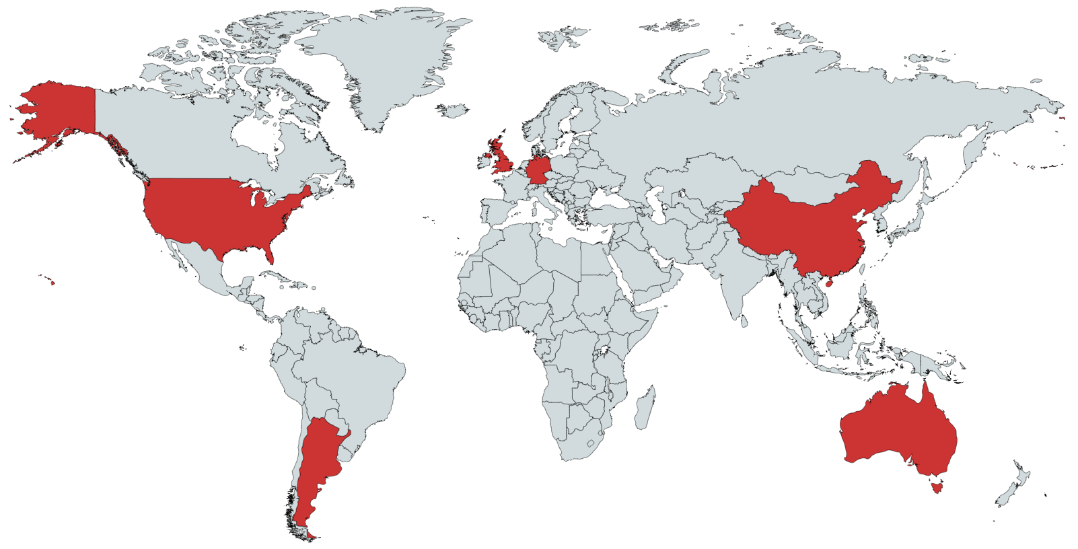
E-QALY International teams
  Argentina (PI Augustovski)
  Australia (PI’s Mulhern/Engel)
  China (PI’s Luo/Yang)
  Germany (PI’s Greiner/Kreimeier)
  United States (PI Pickard)
  United Kingdom (PI Brazier with Peasgood/Mukuria) Lead

Slide 5
Extending the QALY project partners
University of Sheffield
John Brazier (PI)
Clara Mukuria
Donna Rowen
Aki Tsuchiya, Jill Carlton
Janice Connell
Monica Hernandez
National University of Singapore
Nan Lou, Zhihao Yang (Guizhou Medical Uni.)
Institute for Clinical Effectiveness and Health Policy (IECS)
Federico Augustovski
Maria Belizan
EuroQol Research Foundation
University of Illinois
Simon Pickard
Maja Kuharic
Andrea Monteiro
NIHR CLAHRC
Funders
UK Medical Research Council (MRC)
University of Kent
Karen Jones, Stacey Rand
University of Bielefeld
Wolfgang Greiner
Simone Kreimeier
Kristina Ludwig
Ole Marten
Governance & consultation groups
University of Melbourne
Nancy Devlin
Tessa Peasgood
EuroQol Research Foundation
Advisory Group academics, wide range stakeholders
Steering Group key stakeholders & academics
University of Technology Sydney
Brendan Mulhern
Lidia Engel (Deakin)
Public Involvement Group
N=7
NICE Citizen’s Council
NICE
Rosie Lovett, Bhash Naidoo, Juan Carlos Rejon

Slide 6
Project timetable – completed stages in green
Stage I: Identify Domains / Themes
Stage II: Generate long list of items (~100 items)
Stage III: Face validity interviews
Replicated in 5 countries
Consultations: Items for long measure and classifier
Stage IV: Psychometrics
Argentina
Australia
China
Germany
USA
Stage V: Valuation
TTO (Time trade off), DCE and deliberative exercises
Stage VI: Impact
Possible mapping. Impact on existing cost effectiveness studies
Future work: Validity
Notes:
Process draws on qualitative and quantitative evidence and input of stakeholders

Slide 7
Stage 1: Qualitative literature review
The aim of the review was to identify relevant literature to generate potential domains for the new measure.
  “Based on the voice of adult (aged 18 years and over) patients, social care users and carers what is the impact on quality of life and wellbeing of health conditions and interventions (health, social care and public health interventions)?”
Interested in experience of individuals – best reflected in qualitative work
Targeted, transparent review of the qualitative literature (English language)

Slide 8
Identification of evidence – systematic searching across four arms
1. Qualitative reviews of sample of 17 health conditions
2. Qualitative reviews carers + measures
Analysis
Framework analysis using modified model of health and QoL (Wilson and Cleary)
Conceptual model used to develop extraction framework
Consultation
Consultation at all stages with wider team and governance groups
Revised themes and sub-themes
3. Qualitative reviews social care users + measures
4. Qualitative work in development of generic measures
Thematic analysis to develop themes and sub-themes

Slide 9
Domains and sub-domains
Sadness (depressed) /Happiness
Hopeless/hope
Feelings and emotions
Worry (anxiety)/calm
Vulnerable/safe
Anger/frustration
Activity
Self-care
Enjoyable or Meaningful activity/roles
Vision
Hearing
Communication/speech
Mobility
Self-identity
Treated with dignity/respect
Self-worth / self-respect
Autonomy
Autonomy & Control
Coping
Loneliness
Support
Stigma
Belonging / connectedness
Relationships
Positive relationships & Friendship & social engagement
Physical sensations
Pain
Discomfort
Sleep problems
Fatigue
Cognition
Memory
Concentration
Thinking clearly & Decision making

Slide 10
Stage II: Item generation
Drew on terminology from qualitative review
Existing measures and item banks (n=687)
Where there were no existing items, new items developed
Challenges:
  Identifying items that work in a generic context
  Identify items that convey construct without too much information (preference-elicitation in mind)
Result: 97 items for face valuation
Notes:
e.g. cannot be specific about whether we are caring for individuals

Slide 11
Stage III: Face validation
Aim: choose and refine questions for psychometric survey
Interviews: England , Argentina, Australia, China, Germany, USA
Sample: general population, patients, carers and social care users

Slide 12
Face validity studies – International samples
Country | N | Gen pop | Carers | Patients | Social care
Argentina | 24 | 8 | 8 | 0 | 8
Australia | 25 | 4 | 4 | 17 | 0
China | 30 | 0 | 13 | 17 | 0
Germany | 25 | 0 | 12 | 8 | 5
UK | 45 | 6 | 13 | 18 | 8
USA | 19 | 0 | 0 | 19 | 0
Total (n,%) | 168 | 18 (10.7) | 50 (29.7) | 79 (47.0) | 21 (12.5)

Slide 13
Face validation findings
Complementary international results with some differences in item acceptability
Translation created some ambiguity
China: 5 items needed modifications and further clarification to allow completion.
Preference for simpler layouts but more information on context
Resulted in some elimination, modifications and additional items leaving 62 items for the next stage

Slide 14
Stage IV: Psychometric survey
Survey in UK (n=2000, patients/carers/social care users recruited online and from NHS trusts and primary care) and in Argentina, Australia, China, Germany, USA (n=500 to 900 recruited online)
62 E-QALY items and EQ-5D-5L, EQ-5D-3L, VAS, SWEMWBS and ASCOT
Classic psychometric and Item Response Theory analysis – to test dimensionality and item performance

Slide 15
Results: samples
Country | N | Populations
Argentina | 497 | LT condition (64%); Carer (68%); Social Care (58%)
Australia | 514 | LT condition (73%); Health care aid user (57%); Carer (22%);
China | 881 | LT condition (72%); Carer (46%)
Germany | 496 | Healthy people (20%); Cancer (40%); Carer (40%)
UK | 1,923 | LT condition (76%); Carer (31%); Social Care (19%)
USA | 903 | LT condition (69%); Carer (22%); Social Care (10%)
LT – long term
Notes:
Covered all relevant groups. Social care difficult to use as not enough specific questions about the nature of social care being received

Slide 16
Analysis
Distributions of each item (including missing rates, ceiling and floor effects)
Known group difference
  Health conditions (presence vs none, severe vs not severe)
  Carers (high/low hrs)

Slide 17
Domain level
Factor analysis to confirm domain structure
  Bifactor model – estimated on UK first and then confirmed in the 5 other countries. Met standard measures of good fit.
IRT on separate domains – using graded response model.
  Item level fit / Local dependency
  Difficulty/discrimination (category characteristics curves, item information functions)

Slide 18
Extending the QALY instrument sub-domains - profile
Sadness (depressed) / Happiness
Hopeless/hope
Worry (anxiety)/calm
Vulnerable/safe
Anger/frustration
Self-care
Enjoyable or Meaningful activity/roles
Mobility
Self-worth / self-respect
Bifactor model separately accounting for positive and negative. Confirmed in most countries apart from China.
NB: Vision, hearing/communication, sleep and discomfort not included
Autonomy/Control
Coping
Relationships – loneliness, support, stigma, belonging, positive relationships
Pain
Fatigue
Cognition – concentration, thinking clearly, memory
Notes:
Bifactor dimension model generally confirmed across countries:
In China anxiety, safety, anger, happiness, hope, coping, self-worth were combined.
Majority of the items contributed to the domain rather than the positive or negative

Slide 22
Consultation 1 – Views of item reduction for long measure
Advisory Group, EuroQol group, & international stakeholders
Consultation 1 (n=59, 59% from UK):
  Presented summary of all face validity, psychometric evidence
  Select preferred items – at least one for each domain
All country teams recommended version of long measure based on all evidence, including Public Involvement (PI) Group and consultation results
Agreement reached on 25 items:
  one for each sub-domain except pain & discomfort have 2
  Combined: loneliness & friendship/positive relationships; stigma and belonging; concentration and thinking clearly; but no item for dignity/respect

Slide 23
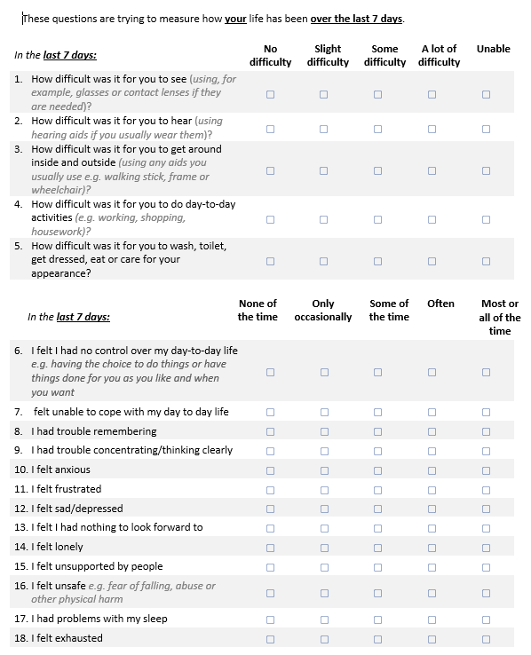
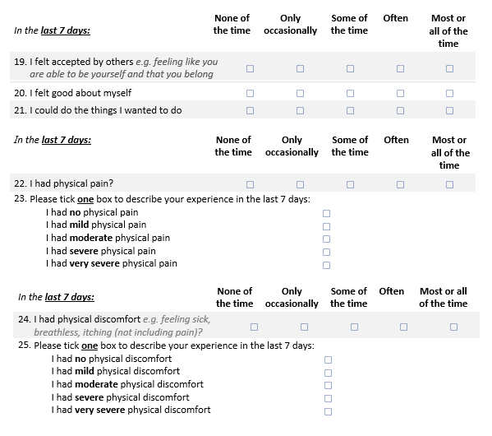
EQ-HWB Long form (25 items)
Vision
Hearing
Mobility
Daily activities
Self-Care
Enjoyable activities
Self-worth
Control
Coping
Loneliness
Support
Stigma/belonging
Memory
Concentrating/ thinking clearly
Frustrated
Sad/depressed
Anxious
Hopeless
Unsafe
Pain
Discomfort
Sleep
Fatigue

Slide 24
Consultation 2 – Views on selection for classifier
Consultation 2 – same groups as before (n=71, 54% from UK):
Presented long version of measure – ask to choose 7-10 for classifier
All countries asked to recommend items for a classifier based on Consultation 2, redundancy (factor and item correlation), psychometric evidence
Agreed 9 items for classifier
NB. EQ Research Foundation owns the intellectual property and has named it the EQ-HWB (‘Health and Well-being’)

Slide 25
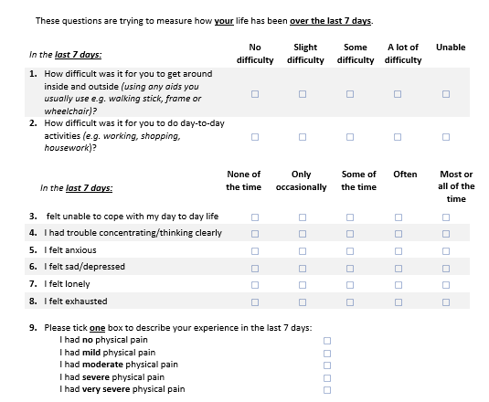
EQ-HWB Short form 9-item descriptive system
Domains/ sub-domains
Mobility
Daily activities
Control
Concentration & thinking clearly
Anxiety
Depression
Loneliness
Fatigue
Pain
Notes:
Mobility How difficult has it been for you to get around inside and outside (using any aids you usually use e.g. a walking stick, frame or wheelchair)? (D)
Daily activity How difficult has it been for you to do day-to-day activities (e.g. working, shopping, housework) (D)
Relationships loneliness I felt lonely (F)
Coping I felt unable to cope with my day to day life (F) / [Control I felt I had no control over my day to day life (e.g. having the choice to do things or have things done for you as you like and when you want] (F)
Anxiety I felt anxious (F)
Fatigue I felt exhausted (F)
Happy I felt sad/depressed (F)
Pain I had [no/slight…] physical pain (S)
Cognitive function I had trouble concentrating/thinking clearly (F)

Slide 26
EQ-HWB short-form
How does it compare to the EQ-5D?
EQ-5D
Domains/ sub-domains
Domains/ sub-domains
Mobility
Self-care
Usual activities
Pain/Discomfort
Anxiety/Depression
Mobility
Daily activities (enjoyable or meaningful activities/roles)
Control
Concentration & thinking clearly
Anxiety
Depression
Loneliness
Fatigue
Pain
Notes:
Such that it can be compared in content with the EQ-5D; it is useful when an intervention is likely to more broadly impact aspects of social care like coping, ability to think or concentrate, and more clearly delineated aspects of mental health

Slide 27
Stage V: Valuation
Completed:
Pilot study using EQ-PVT v2 valuation protocol i.e. computer assisted TTO and DCE with n=15 qualitative interviews
Resulted in some minor modifications
Next steps:
Further pilot valuation – quantitative (n=50)
Main valuation study in UK (n=460) with 7 TTO and DCE, but may be online only
DCE with duration – mixed methods exploratory study (PhD)
Deliberative exercise with NICE Citizen’s Council

Slide 28
Concluding remarks
Strengths
EQ-HWB is a new generic measure that goes beyond conventional measures of health to include aspects of well-being relevant to patients, social care users and carers
Rigorous methods used to identify domains/sub-domains and items with valuation in mind from the start
A large international project
Extensive consultation with stakeholders at all stages (e.g. https://www.nice.org.uk/news/article/nice-to-work-with-partners-on-developing-new-ways-to-measure-quality-of-life-across-health-and-social-care)
Future work
Further psychometric testing of items needed – e.g. responsiveness, recruit more beyond online (currently only n=627 from health care setting)
Need to be understand how it compares to existing measures
Need further work in different countries and cultures
Currently a draft version subject to further refinement by the EQ Group

Slide 29

Thanks you!
Project Website: https://scharr.dept.shef.ac.uk/e-qaly/project-updates/

