Slide 1
Development, use and future of the SF-6D preference-based measure of health
John Brazier, PhD, FMedSci
Professor of Health Economics and Dean,
School of Health and Related Research, University of Sheffield, UK
j.e.brazier@Sheffield.ac.uk

Slide 2
Overview
Development of SF-6D from the SF-36 – the descriptive system and it’s valuation
Performance and use of SF-6D
Development of the SF-6Dv2 – rationale, methods and comparison to original SF-6D
Translation and valuation of SF-6Dv2 in China by Wu et al at Tianjin University

Slide 3
The SF-36
36 item questionnaire
Measures general health across 8 dimensions:
Physical Functioning; Role Limitations due to Physical problems; Role limitations due to Emotional problems; Social Functioning; Pain, Vitality, Mental Health; General Health
Produces two summary scores (Physical Component Summary and Mental Component Summary)
One of the most widely used measures of HRQoL in the world
Validated across a wide range of health conditions
Notes:
Standard (psychometric) measures of HRQoL such as the SF-36
describe health in various dimensions
but do not explicitly incorporate preference information but use scoring algorithm based on simple summative scoring or more recently RASCHE analysis
There are a class of measures of health related quality of life known as Multi-attribute utility measure (such as the HUI or the EQ-5D) which have been designed for use in economic evaluation. These:
- also describe health, though usually on a cruder scale
these incorporate preference weights derived from sample of the general population reflecting the value people give to different aspects of health
these can be used to value health states and calculate QALYs
The rationale for this study were:
that the SF-36 is the most widely used generic measure of health whereas MAUS have only been used in a limited way
- there has been some concern about the relevance and sensitivity of existing MAUS for many conditions and treatment outcomes.

Slide 4
SF-36 Physical Functioning items
The following questions are about activities that you might do during a typical day. Does your health limit you in these activities? If so, how much?
(circle one number on each line)
ACTIVITIES | Yes, limited a lot | Yes, limited a little | No, not limited at all
a. Vigorous activities, such as running, lifting heavy objects, participating in strenuous sports | 1 | 2 | 3
b. Moderate activities, such as moving a table, pushing a vacuum cleaner, bowling or playing golf | 1 | 2 | 3
c.Lifting or carrying groceries | 1 | 2 | 3
d. Climbing several flights of stairs | 1 | 2 | 3
e. Climbing one flight of stairs | 1 | 2 | 3
f. Bending, kneeling or stooping | 1 | 2 | 3
g. Walking more than a mile | 1 | 2 | 3
h. Walking half a mile | 1 | 2 | 3
i. walking 100 yards | 1 | 2 | 3
j. Bathing and dressing yourself | 1 | 2 | 3

Slide 5
SF-36: Comparison of general population and patients with Rheumatoid Arthritis

Slide 6
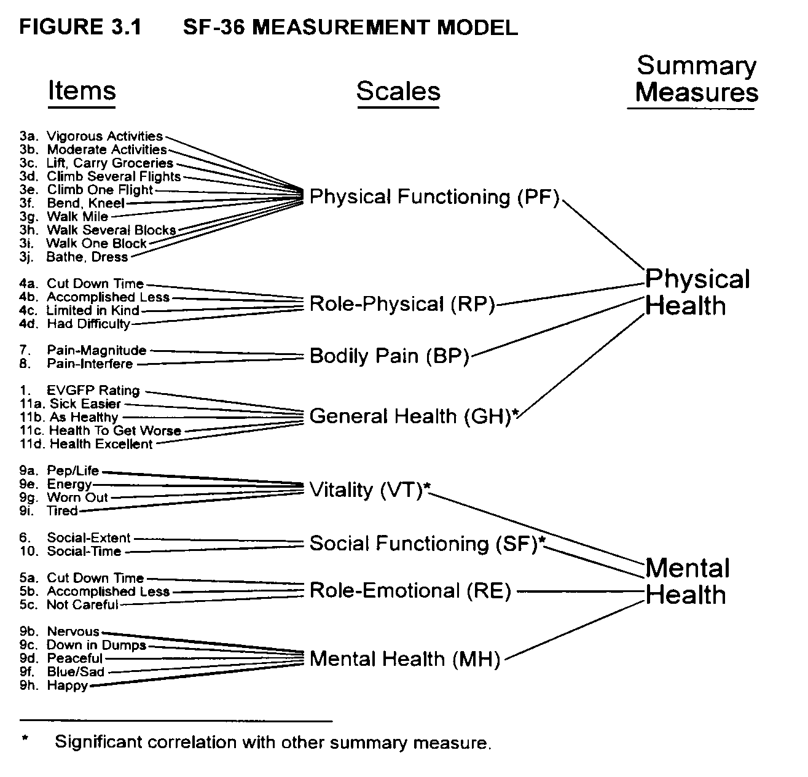
Physical
Mental

Slide 7
Derivation of SF-6D from SF-36
Reduced SF-36 from 8 to 6 dimensions by removing general health dimension and combining role limitations due to physical and emotional problems
SF-6D has Physical functioning, role limitation, social functioning, pain, mental health, vitality
Used 11 of 36 items selected using early factor analytic and Rasch results (for physical functioning)
Notes:
The Short-Form 6-D health state classification was formed by selecting items from the SF-36:
The number of dimensions was reduced from 8 to 6. This was done by dropping the general health dimension of the SF-36 since the purpose of the exercise is to derive an overall value for health. And by combining the two role limitation dimensions.
Within the 6 dimension items were selected in order to minimise the overall information loss. Dr. John Ware and his colleagues contributed to this process and provided evidence for the psychometric performance of each item in explaining each health concepts across the severity range (including the results of factor and rasche analysis).
The result is the SF-6D with dimensions for physical functioning, role limitation, social functioning, pain, mental health and vitality
Each dimension has between 4 and 6 levels of severity
A SF-6D Health state is defined by selecting one level from each dimension
In this way the SF-6D defines 18,000 health states
SF-36 data can be assigned to the new classification

Slide 8
First health utility estimate from psychometric tool
Physical
SF-6D (Uses 11 items)
Mental

Slide 9
SF-6D
The following questions ask about different aspects of your health. There are six groups of statements, each covering a different aspect of health. Please tick one statement in each group to show the statement which best describes your health over the past 4 weeks.
Physical Functioning
Your health does not limit you in vigorous activities…….□
Your health limits you a little in vigorous activities……....□
Your health limits you a little in moderate activities…......□
Your health limits you a lot in moderate activities…….....□
Your health limits you a little in bathing and dressing......□
Your health limits you a lot in bathing and dressing……...□
Role Limitations
You have no problems with your work or other regular daily activities as a result of your physical health or any emotional problems.......…………..□
You are limited in the kind of work or other activities as a result of your physical health……□
You accomplish less than you would like as a result of emotional problems……...…...........□
You are limited in the kind of work or other activities as a result of your physical health and accomplish less than you would like as a result of emotional problems……□
Social Functioning
Your health limits your social activities none of the time…...□
Your health limits your social activities a little of the time.....□
Your health limits your social activities some of the time…..□
Your health limits your social activities most of the time…...□
Your health limits your social activities all of the time……....□
Pain
You have no pain……...…………………………□
You have pain but it does not interfere with your normal work (both outside the home and housework) ……..□
You have pain that interferes with your normal work (both outside the home and housework) a little bit…………□
You have pain that interferes with your normal work (both outside the home and housework) moderately…........□
You have pain that interferes with your normal work (both outside the home and housework) quite a bit………...□
You have pain that interferes with your normal work (both outside the home and housework) extremely………...□
Mental Health
You feel tense or downhearted and low none of the time......□
You feel tense or downhearted and low a little of the time.....□
You feel tense or downhearted and low some of the time…..□
You feel tense or downhearted and low most of the time…...□
You feel tense or downhearted and low all of the time………□
Vitality
You have a lot of energy all of the time…….....□
You have a lot of energy most of the time........□
You have a lot of energy some of the time…...□
You have a lot of energy a little of the time…..□
You have a lot of energy none of the time……□

Slide 10
Valuation of SF-6D
States to be valued: 249 SF-6D health states (out of a possible 18,000) selected on basis of orthogonal design supplemented by additional random selection
Sample: representative sample of 836 members of UK general population interviewed (65% response rate)
Valuation technique: respondents asked to rank and value six SF-6D health states using the ‘ping pong’ variant of standard gamble

Slide 11
Modelling issues
Started with a simple additive OLS model with dimension levels entered as a dummy variables
Issues:
Individual (observations =3518) vs. mean (observations =249) level modelling
Hierarchical data at individual level - used random effects model
Skewness – so examined alternative functional forms
Interactions - used various summary ‘extreme’ and ‘count’ measures (called most or worst)
Bayesian modelling (Kharroubi et al, 2007)
Notes:
The aim was to model the value of all health states defined by the sf-6D from the sample of health state values. The starting point was a simple additive model with each dimension level entered as a dummy variable on estimated by OLS.
There was a choice as to whether to estimate a model at the level of individual observation or mean health state value – we have estimated both and found it makes little difference
to allow for the hierarchical structure of the data from the fact that each respondent was providing a number of observations a RE model was used
a variety of functional forms were examined to deal with the skewness in the data
interactions were considered in a variety of ways

Slide 12
Modelling results
Estimates:
estimates of ‘main effects’ robust across specifications
broadly consistent with 6D (though some inconsistencies)
pain, mental health and physical functioning had largest effects
Fit:
predictions: 79% within +/- .1 and 53% within +/- 0.05
tendency to over predict at the lower end (predictions 0.301 to 1.0 compared to observed values of 0.21 to 1.0)
Notes:
The estimate of the ‘main effects’, that is the decrements associated with each dimension level, were found to be robust to the precise model specification
In terms of results, pain, mental health and physical functioning have largest effects
Most, though not all the decrements were significant and consistent with the ordinality of the scales
predictions: 79% correct to within +/- .1 and - 53% correct to within +/- 0.05
explanatory power in those models with an adjusted R-squared was upto 0.51 for mean models
Despite the interaction term, the tendency remains to over predict actual health state values at the lower end

Slide 13
SF-6D scoring algorithm
Physical functioning PF23 -0.035 PF4 -0.044 PF5 -0.056 PF6 -0.117 | Social functioning SF2 -0.057 SF3 -0.059 SF4 -0.072 SF5 -0.087 | Pain PN23 -0.042 PN4 -0.065 PN5 -0.102 PN6 -0.171
Role limitation RL 234 -0.053 | Mental health MH 23 -0.042 MH4 -0.100 MH5 -0.118 | Vitality V234 -0.071 V5 -0.092
Interaction term MOST -0.061 (if at 3 most serious levels for PF or at 2 most serious levels for any other dimension)

Slide 14
Scoring - SF-6D state 424333
Physical functioning PF2 -0.035 PF3 -0.035 PF4 -0.044 PF5 -0.056 PF6 -0.117 | Social functioning SF2 -0.057 SF3 -0.059 SF4 -0.072 SF5 -0.087 | Pain PN2 -0.042 PN3 -0.042 PN4 -0.065 PN5 -0.102 PN6 -0.171
Role limitation RL 2 -0.053 RL 3 -0.053 RL 4 -0.053 | Mental health MH 2 -0.042 MH 3 -0.042 MH4 -0.100 MH5 -0.118 | Vitality V2 -0.071 V3 -0.071 V4 -0.071 V5 -0.092
Interaction term MOST -0.061 (if at 3 most serious levels for PF or at 2 most serious levels for any other dimension)
Utility score = 1- 0.044 - 0.057 - 0.065 - 0.053 - 0.042 - 0.071 - 0.061 = 0.607

Slide 15
Information loss of moving from SF-36 to SF-6D index – standardise response means for longitudinal change (mean change ÷ SD)
Condition | SF-36 Dimension (best) | Physical | Mental | Index
COPD | 0.03-0.66 (GH) | 0.47 | 0.15 | 0.25
OA medical | 0.09-0.78 (RP) | 0.56 | 0.28 | 0.53
OA surgical | 0.13-0.69 (PF) | 0.49 | 0.02 | 0.38
Seniors | 0.01-0.08 (RP) | 0.05 | 0.06 | 0.07
Leg ulcer | 0.19-0.57 (SF) | 0.52 | 0.24 | 0.53
Depression | 0.01-0.85 (RE) | 0.18 | 1.02 | 0.33
IBS | 0.07-0.41 (MH) | 0.03 | 0.44 | 0.24
RA | 0.20-0.77(RP) | 0.48 | 0.36 | 0.30
Migraine | 0.22-1.06 (RP) | 0.71 | 0.38 | 0.55

Slide 16
Why use the SF-6D?
Scientific arguments:
For most conditions retains the sensitivity of SF-36
Includes vitality, role and social activity not covered by EQ-5D (only ‘usual’ activity in EQ-5D) or HUI3
Evidence of a ceiling effect in the EQ-5D: a large number in the best state, despite other instruments suggesting health problems
Evidence of SF-6D being more sensitive than EQ-5D in some patient groups: general population sample (Petrou and Hockley, 2005), hearing (Barton et al, 2004, visual acuity in AMD (Espallargues et al, 2005), Neck pain patients (Epstein and Mara, 2003), leg reconstruction (Burton et al, 2006)
Translated and valued in 5 other countries: Japan, Brazil, Spain, China (Hong Kong), Australia

Slide 17
Criticisms of original SF-6D
Comparatively narrow score range (0.3 to 1.0; compared to -0.564 to 1.0 for EQ-5D)
Problems with standard gamble in some countries (e.g. Japan and Brazil)
Evidence of SF-6D suffering from floor effects i.e. insensitive in poor health states (particularly role limitation)
Inconsistencies (e.g. vitality)

Slide 18
Developing a new version of the SF-6D

Slide 19
Development
Methods of item selection:
factor analysis, other psychometric evidence
cross-cultural considerations
amenability to valuation
Resulted in better informed item selection
Resulted in the following modifications to SF-6D:
Selected 10 items to cover 6 dimensions
Simpler classification of physical function with clearer separation between levels
Revised 5-level description of role limitations (reduces number on worst from 32% to 10%; Whitehurst et al, 2020)
uses negative wording to describe vitality
uses pain severity rather than pain interference

Slide 20
SF-6Dv2
Physical functioning
Limited in vigorous activities not at all
Limited in vigorous activities a little
Limited in moderate activities a little
Limited in moderate activities a lot
Limited in bathing and dressing a lot
Role limitations
Accomplish less than you would like none of the time
Accomplish less than you would like a little of the time
Accomplish less than you would like a some of the time
Accomplish less than you would like most of the time
Accomplish less than you would like all of the time
Social functioning
Social activities are limited none of the time
Social activities are limited a little of the time
Social activities are limited some of the time
Social activities are limited most of the time
Social activities are limited all of the time
Pain
No pain
Very mild pain
Mild pain
Moderate pain
Severe pain
Very severe pain
Mental health
Depressed or very nervous none of the time
Depressed or very nervous a little of the time
Depressed or very nervous some of the time
Depressed or very nervous most of the time
Depressed or very nervous all of the time
Energy
Worn out none of the time
Worn out a little of the time
Worn out some of the time
Worn out most of the time
Worn out all of the time

Slide 21
Valuation: Discrete Choice Experiment
 | Health description A | Health description B
 | You live for 10 years in the following health state then you die | You live for 8 years in the following health state then you die
 | Limited in moderate activities a little | Limited in vigorous activities a little
 | Accomplish less than you would like some of the time | Accomplish less than you would like a little of the time
 | Social activities are limited most of the time | Social activities are limited most of the time
 | Moderate bodily pain | Mild bodily pain
 | Very nervous or down and depressed some of the time | Very nervous or down and depressed none of the time
 | Worn out a little of the time | Worn out all of the time
 | Which is best?

Slide 22
UK Valuation study
Study design and setting
An online sample representative of the UK general population (n=3,060)
DCE with duration choice sets taken from an efficient design of 300
Conditional logit regression models to estimate values compared for inconsistency and BIC
Examined heterogeneity
Results
A model with ordered coefficients within each dimension (only vitality levels 2/3 inconsistent)
utility values range from -0.574 (15% worse than dead) to 1.0
Most important dimension was pain, then mental health, physical, social and role functioning and vitality.

Slide 23
SF-6D score (decrements)
Physical functioning PF2 0.019 PF3 0.032 PF4 0.091 PF5 0.198 | Social functioning SF2 0.009 SF3 0.025 SF4 0.102 SF5 0.135 | Pain PA2 0.074 PA3 0.097 PA4 0.141 PA5 0.462 PA6 0.618
Role limitation RL 2 0.038 RL3 0.056 RL4 0.098 RL5 0.100 | Mental health MH2 0.025 MH3 0.085 MH4 0.236 MH5 0.325 | Vitality V2 0.018 V3 0.018 V4 0.083 V5 0.125
Interaction term WORST -0.084 (if at 3 most serious levels for PF or at 2 most serious levels for any other dimension)

Slide 24
Translation and valuation of SF-6Dv2 in China
By
Jing Wu*, Shitong Xie JW*, Xiaoning He*, Gang Chen, John Brazier
* School of Pharmaceutical Science and Technology, 209-4, 24th building, Tianjin University, 92th Weijin Road, Nankai District, Tianjin, China

Slide 25
Translation of SF-6Dv2 in China (Wu et al, 2020)
Translated and culturally adapted for China
Followed the international guidelines: forward translation by two independent translators and reconciled; independent backward translation; harmonisation and then approval
Face-to-face cognitive debriefing was carried out in a small sample of the Chinese general population, using both think-aloud and retrospective probing methods.
Result: A simplified Chinese version

Slide 26
Table 1 The comparison of original English version and translated Simplified Chinese version of SF-6Dv2 (Physical Functioning and Role Limitation dimensions)
 | The original English version of SF-6Dv2 | The initial translation of Simplified Chinese version of SF-6Dv2 | The final Simplified Chinese version of SF-6Dv2
Physical Functioning | Does your health now limit you in your daily physical activities? Not limited at all in vigorous activities (such as running, lifting heavy objects, participating in strenuous sports) Limited a little in vigorous activities (such as running, lifting heavy objects, participating in strenuous sports) Limited a little in moderate activities (such as moving a table, pushing a vacuum cleaner, bowling, or playing golf) Limited a lot in moderate activities (such as moving a table, pushing a vacuum cleaner, bowling, or playing golf) Limited a lot in bathing and dressing | 您的健康现在限制了您的日常身体活动吗？ 高强度活动（如跑步、抬起重物、参加剧烈运动）完全没有限制 高强度活动（如跑步、抬起重物、参加剧烈运动）受到一点限制 中等强度活动（如搬桌子、拖地板、打保龄球或打太极拳）受到一点限制 中等强度活动（如搬桌子、拖地板、打保龄球或打太极拳）受到很大限制 洗澡和穿衣受到很大限制
Role Limitation | During the past 4 weeks, how much of the time have you accomplished less than you would like at work or during other regular daily activities as a result of your physical health or emotional problems? None of the time A little of the time Some of the time Most of the time All of the time | 在过去4个星期中，您在工作或其它日常活动中，有多少时候会由于身体健康或情绪问题而未全部完成预期想要完成的工作？ 从来没有 偶尔 有时 大部分时间 常常如此 | 在过去4个星期中，您有多少时候会由于身体健康或情绪问题，而导致实际完成的工作或其他日常活动比想要完成的少？ 从来没有 很少 有时 大部分时间 一直如此
The examples changed during the translation are underlined using dots. The modified sentence and response levels through cognitive debriefing interviews were underlined.

Slide 27
Valuation of SF-6Dv2 in China
Methods:
Preliminary valuation study - comparing TTO and DCE with duration (Xie et al, 2020)
Main valuation study - stratified sampling method with four quotas (age, gender, education level and urban/rural split)with a large representative general population sample (n=3320) (unpublished)
Key findings:
Both DCE and TTO found to be feasible, though DCE produced more inconsistencies
Range of DCE TTO values similar to UK (-0.535 to 1.0), though larger than TTO (-0.276 to 1.0)
Most important dimension was physical functioning, followed by pain, mental health, social, vitality and role limitation
– different to UK

Slide 28
Concluding remarks
SF-6D takes advantage of the wide spread use of the SF-36 and can be used stand alone
Accepted by 20 out of 42 Health Regulatory Agencies around the world (including China)
Value sets available in 6 countries (including China)
SF-6D second most widely used generic preference-based measures after EQ-5D – over 1400 licenses distributed since 2013
Version 2 provides an important potential advances
Conclusion: SF-6Dv2 offers an important way to obtain health utility values for estimating Quality Adjusted Life Years
For more information:
https://www.sheffield.ac.uk/scharr/sections/heds/mvh/sf-6d

Slide 29
Reference
Brazier J, Roberts J, Deverill M. The estimation of a preference-based measure of health from the SF-36. Journal of Health Economics. 2002; 21: 271-92.
Brazier JE, Mulhern BJ, Bjorner JB, et al. Developing a New Version of the SF-6D Health State Classification System From the SF-36v2: SF-6Dv2. Medical care. 2020; 58: 557-65.
Mulhern BJ, Bansback N, Norman R, et al. Valuing the SF-6Dv2 Classification System in the United Kingdom Using a Discrete-choice Experiment With Duration. Medical care. 2020; 58: 566-73.
Shitong Xie JW, Xiaoning He, Gang Chen, John E. Brazier. Do Discrete Choice Experiments Approaches Perform Better than Time Trade-off in Eliciting Health State Utilities? Evidence from SF­6Dv2 in China. Value in Health. 2020.
Wu J, Xie S, He X, et al. The Simplified Chinese version of SF-6Dv2: translation, cross-cultural adaptation and preliminary psychometric testing. Quality of life research : an international journal of quality of life aspects of treatment, care and rehabilitation. Quality of Life Research 2020.

