Slide 1
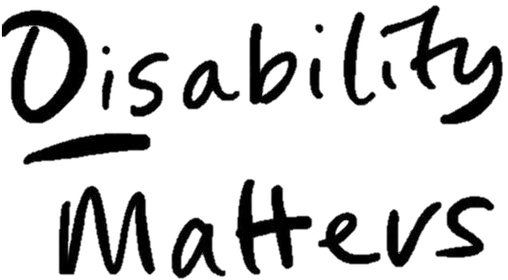

“How does disability transform research cultures and workplace environments?”
@ Disability Matters’ Inclusive Research Cultures: Knowledge Exchange Workshop
30th April 2026
Dr Armineh Soorenian (she/her)
Wellcome Anti-Ableist Research Cultures (WAARC)

Slide 2




What is the WAARC project?
Set up to:
Bring together researchers, professional services colleagues and partner organisations.
Develop a suite of activities that centre disability and contest systemic ableism.
Promote anti-ableism in the University of Sheffield.

Slide 3
WAARC’s priority areas
Anti-Ableist Environments: Recruitment and Employment
Anti-Ableist Developments: Inclusive Events and Inclusive Research Methods Training
Collaborative Inquiry: Funding & Collaborating with several smaller projects, and Cripping the Research Concordat
Cross-Cutting/Knowledge Exchange

Slide 4
Priority Area 1: Anti-Ableist Environments
Priority Area 1.1: Recruitment addresses the under-recruitment of Disabled researchers and professional services staff due to structural barriers.
Priority Area 1.2: Employment addresses the attraction and retention of Disabled researchers and professional services staff.

Slide 5
What did we do? (1/2)
We interviewed 30 staff members – both Disabled and non-disabled – from both research and professional services.
We asked our participants to discuss their recruitment and employment experiences at the University of Sheffield.
Participants shared information about ableist practices within their work environments and recommended ways to remove the barriers they identified.

Slide 6
What did we do? (2/2)
In collaboration with our partner organisation, Pathfinders, we transcribed and analysed the interviews.
We identified the following themes:
Lack of accessible and relevant information
Ableist attitudes
Gaps in support provision

Slide 7
Key findings
Precarious employment, often contract-based.
Culture of overworking – unreasonable expectation.
Demanding leadership criteria of Academic Career Pathway.
Staff expected to:
Work long hours
Be constantly productive
Deal with precarious contracts and inflexible funding streams

Slide 8
Ableist attitudes
Judgements and assumptions about impairments, capabilities and needs.
Preconceptions impacted progression of Disabled staff.
Stereotypical view of higher costs and lower productivity.
Lack of support led to reduced opportunities for progression.
Lack of awareness around disability.
Difficulty socialising and developing workplace relationships – sometimes resulting in total isolation.

Slide 9
Ableist practices
Inaccessible information/communication systems, work structures and processes.
Insufficient information and options for career progression.
Fear that changing teams could lead to cessation of support.
Inaccessible training platforms, systems, venues and schedules.

Slide 10
Fostering an inclusive work culture
A work culture which desires and welcomes Disabled people.
Redefine disability as a tool for creativity, liberation, adaptation and thinking outside the box – for changing the status quo.
Consult with Disabled people to co-create inclusive work cultures.

Slide 11
Participants’ recommendations
Develop policies and procedures – and follow them!
Support a transition in attitude from begrudging tolerance to genuine inclusion.
Recognise complex interactions between impairments and institutional barriers.
Provide accessible information around professional development and progression.
Allocate protected time for Disabled staff to work towards promotion.
Offer one-to-one support around funding applications for Disabled staff.

Slide 12
Benefits of an inclusive work culture
Meet each other’s access needs.
Find new ways of being within our work community.
Hope for an accessible and creative future.
Centre inter-dependence; not independence.

Slide 13
Prompt questions
How would you foster inclusion to transform your research cultures?
In what ways can we use disability as a tool for collective action to create accessible and inclusive workspaces?

Slide 14
Dr Armineh Soorenian
Wellcome Anti-Ableist Research Cultures (WAARC)
iHuman, University of Sheffield
a.soorenian@sheffield.ac.uk
https://sheffield.ac.uk/ihuman/who-we-are/armineh-soorenian

