Slide 2
Restorative Approaches to Leadership

Slide 3
There are a number of ways restorative leadership can be seen at Brightlink:
Recruitment
Organisation set up and policy support
People management
Language and mindset
Strategy
Positive feedback activity
Needs activity
Meetings

Slide 4
Brightlink Learning
Relationship Management Policy & Procedures
Purpose and Scope of Policy
Brightlink Learning works with associates, consultants, learners, participants and clients, a number of partner organisations, contributors and other stakeholders.
This document is intended to provide guidance on how best to establish, develop, maintain, manage and if necessary, repair relationships, networks and partnerships in order to ensure that needs and strengths are at the centre of all working.
At all times Brightlink will work in a way which:
places people and relationships at the centre of everything undertaken, working with them rather than for them or to them;
demonstrates and models restorative working;
demonstrates the best of expertise, infrastructure, value, skills and commitment;
utilises and shares the best strengths, assets and skills of each team member;
shares learning;
is based on open, honest and trusting relationships;
is proactive in seeking opportunities for partnership.

Slide 5
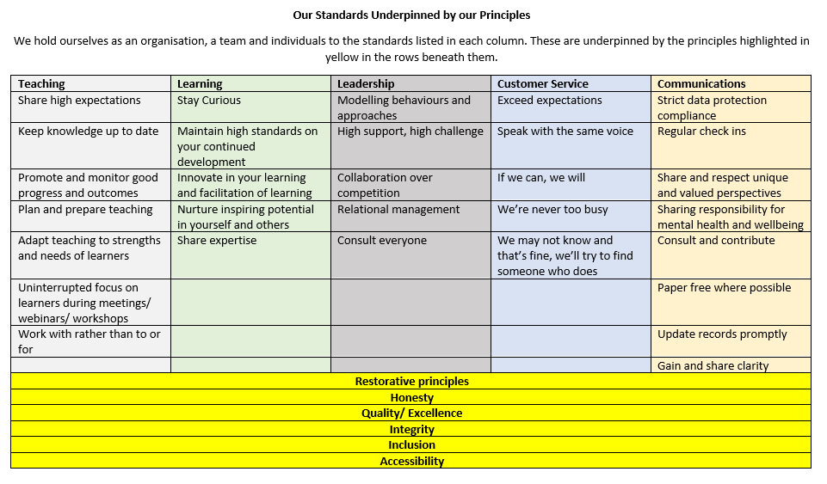

Slide 6
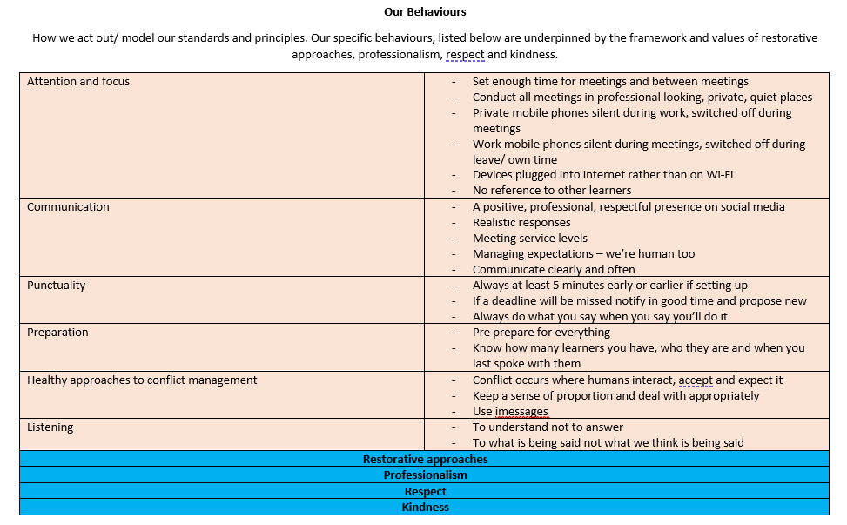

Slide 7
“ If you’re not modelling what you teach, you’re teaching something else.”
Belinda Hopkins

Slide 8


Slide 9
Agenda
Check in.
How you are.
Something you’re celebrating/ what’s going well at work at the moment?
2. Agenda items.
3. Check out.
Your most important action from today/ the first action from the meeting you’ll do when you leave today.
Something you’re looking forward to.

Slide 10
Tolerance | Compassion | Empathy
Positivity | Honesty | Humour
Sensitivity | Belonging | A listening ear
Gratitude | Kindness | A sense of purpose
Hope | Warmth | Supportive challenge
Love | Clarity | Reassurance
Fairness | Friendship | Acceptance
Optimism | Trust | Support
Respect | Understanding | Patience
Inspiration | Safety | Recognition
Affirmation | Inclusion | Encouragement
Consideration | Co-operation

Slide 11
What happened?
What were you thinking, how were you feeling?
Who was affected and how?
What has happened since?
What do you need to put things right?
What do you want to happen next in order to move forward?

Slide 12
Other models and examples of restorative leadership:
Co-operatives .
Consortia.
Flattened structures.
Employee ownership.

