Slide 1
Graduate Immigration Route
A guide to making the GIR visa application
International Student Support, Advice & Compliance Team
Updated November 2025

Slide 2
About this guide
This guide is intended to help Sheffield University graduates who are applying for a Graduate Immigration Route (GIR) visa in the UK and has been created by the the International Student Support, Advice & Compliance team (ISSAC)
This document should be used for guidance only. The University does not take responsibility for visa applications submitted using this guide
Information provided is correct as of November 2025. Application forms, immigration rules & guidance are subject to frequent changes. Always check most recent visa guidance at time of application, see useful resource link below
Most applicants will make their application digitally, using the UKVI IDV app to register biometrics and completing an online application form. If you cannot use the IDV app you can book a biometric appointment at a visa application centre
In most cases you will already have set up a UKVI account (to access your digital E visa), go to https://www.gov.uk/graduate-visa/apply to start your application
The ISSAC team at the University does not routinely offer 1:1 application form checks for this type of visa but can answer queries about eligibility and the application process. See our Contact details
You can come to our Wednesday work visa drop in in ISSAC Office L3 Student Union Building
If you have issues with the application during or after submission, you will need to contact UKVI

Slide 3
Useful resources
University of Sheffield website https://www.sheffield.ac.uk/post-study-support/immigration/after-studies/graduate-route
UKVI overview & link to application https://www.gov.uk/graduate visa
Immigration Rules https://www.gov.uk/guidance/immigration
rules/immigration rules appendix graduate
Graduate route caseworker guidance-https:// www.gov.uk/government/publications/graduate caseworker guidance
Guide to Using UKVI ID APP https://www.gov.uk/guidance/using-the-uk-immigration-id-check-app

Slide 4
Are you ready to apply?
To check your eligibility see https://www.gov.uk/graduate-visa, and https://www.sheffield.ac.uk/post-study-support/immigration/after-studies/graduate-route for more information
You should only apply if
You are inside the UK
You have a valid Student visa at the time of the application
You have received your official results and successfully completed your degree and
You have received an email from ISSAC, to confirm that we have reported your successful completion to UKVI (this email will provide your last CAS number which you will need for the application)
If you apply before successful completion has been reported your application could be refused and you could lose your application fee
Email graduateroute@sheffield.ac.uk if you have not received this email but have received your ‘official results’ so that we can look into this for you
Also get in touch if your vsa is about to exiref your student visa is about to expire

Slide 5
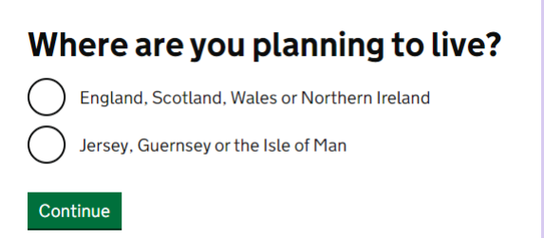
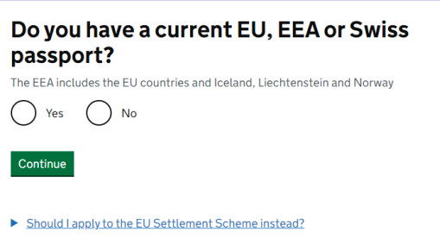
How to Apply
To apply go to https ://www.gov.uk/graduate visa/apply
Answer as appropriate

Slide 6
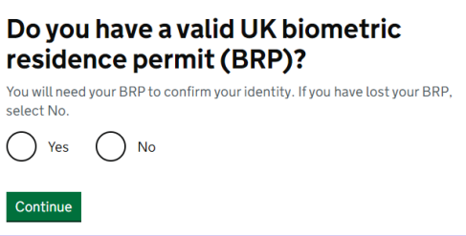
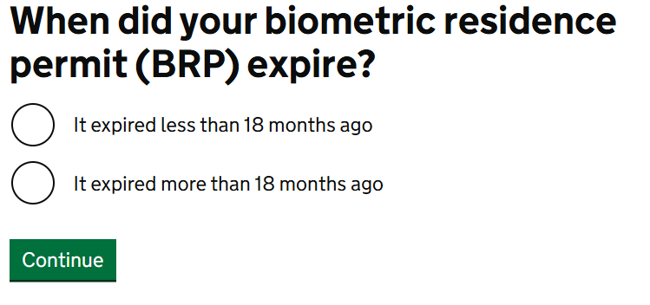
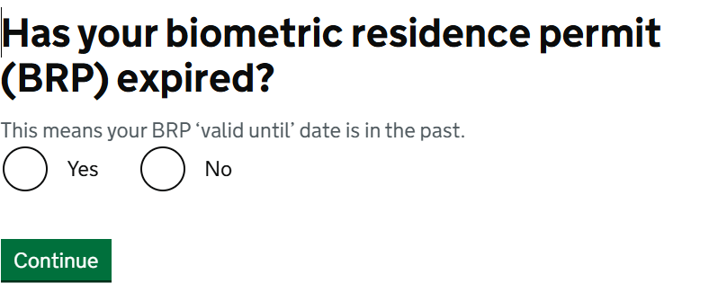
Starting the application
Answer as appropriate. Most BRP’s will have expired in December 2024 and were replaced with E visas.

Slide 7
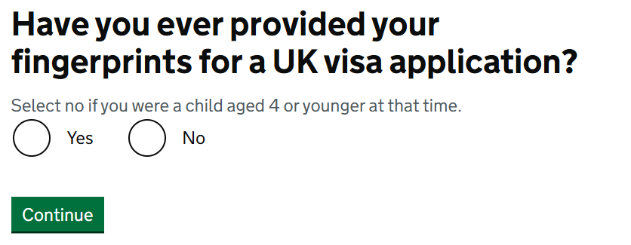
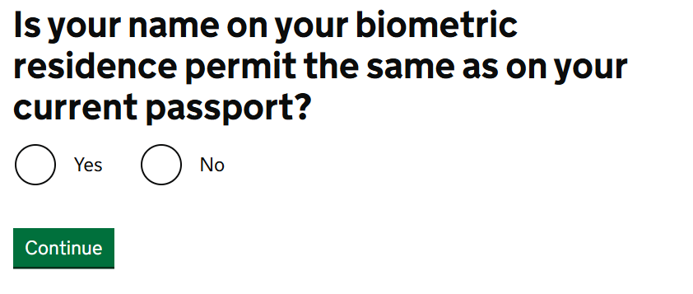
Questions to establish if you can use IDV app
Answer as appropriate
Answer as appropriate

Slide 8
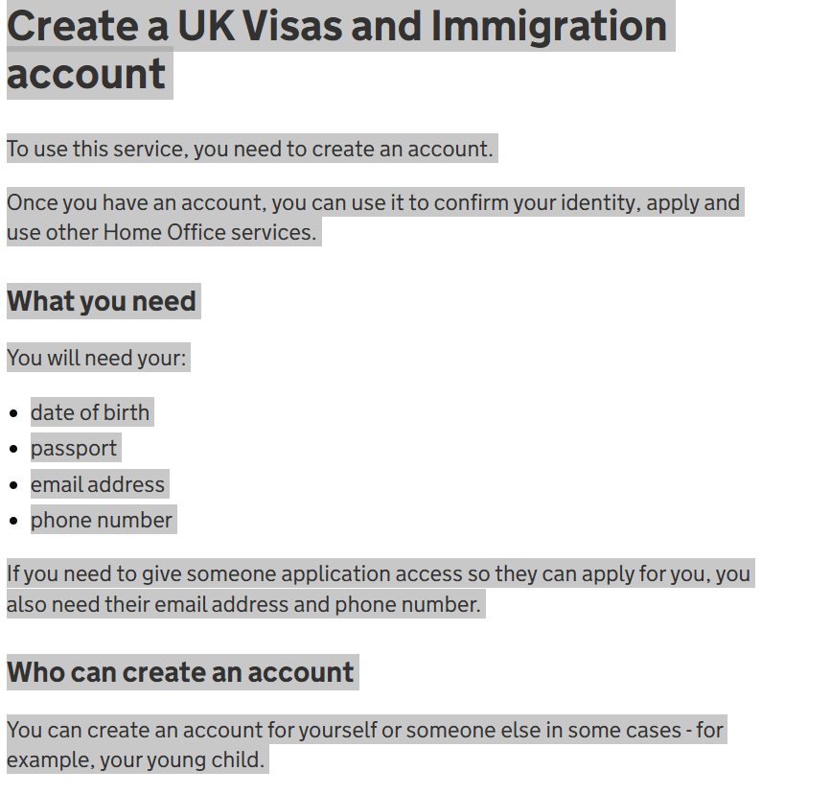
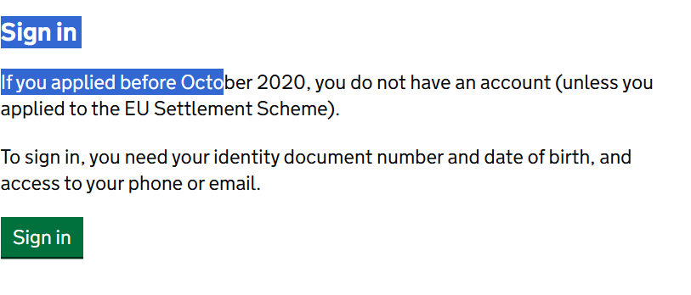

Either create or sign into your UKVI account
From 1 January 2025 you should have already created a UKVI account to access your E visa. In which case you will just need to sign into your existing UKVI account.

Slide 9
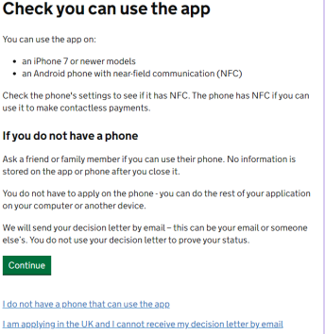
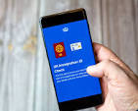
Using the UKVI IDV APP to register your biometrics
For tips on how to use the UKVI IDV app see https://www.gov.uk/guidance/using-the-uk-immigration-id-check-app
If you do not have or cannot borrow a smartphone which has near field communication (NFC) contact ISAAC as we can help with this
Don’t worry if you cannot use the IDV app, you will be able to book appointment at a visa application centre to register biometrics and complete online form.
You can download the app via google or apple play store
You will need to link the ID App to your UKVI account using QR code
Once you have confirmed your identity using on the ID app you can complete the rest of the application on any device e.g. PC, laptop or smartphone

Slide 10
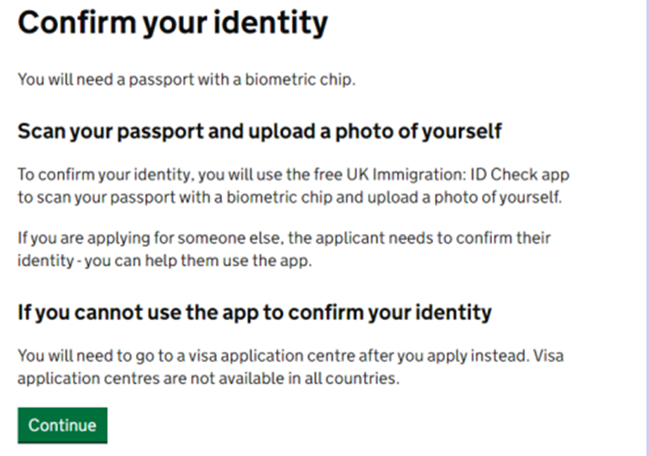
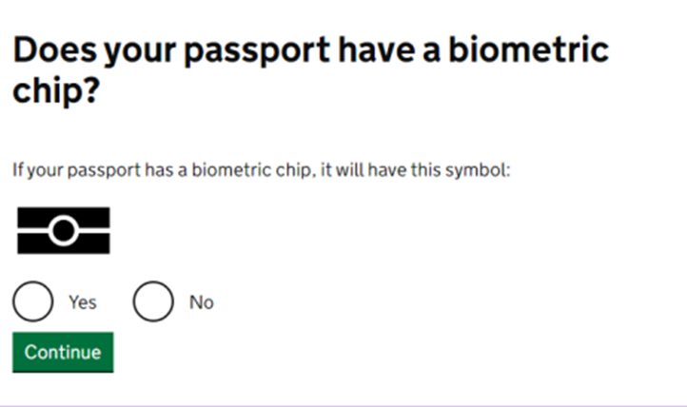
Confirm your Identity
If you do not have an ID document with biometric chip you will not be able to use the ID app and may need to use visa application centre to submit biometrics

Slide 11
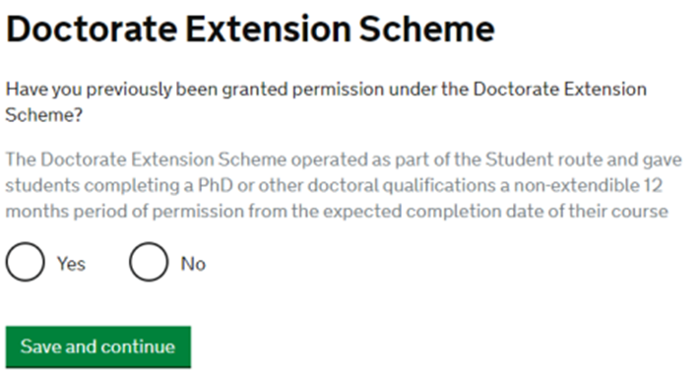
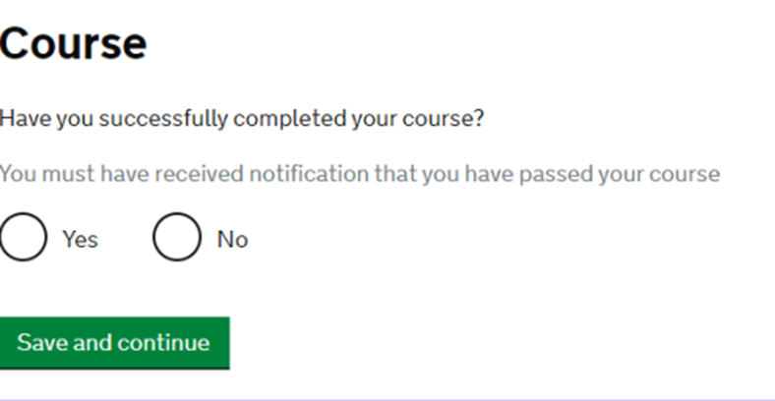
You should have your official results and email from ISSAC team to confirm we have reported this to UKVI before you apply
Unless you have previously completed a PhD in the UK, you will not have had ths visa so most applicants will say No

Slide 12
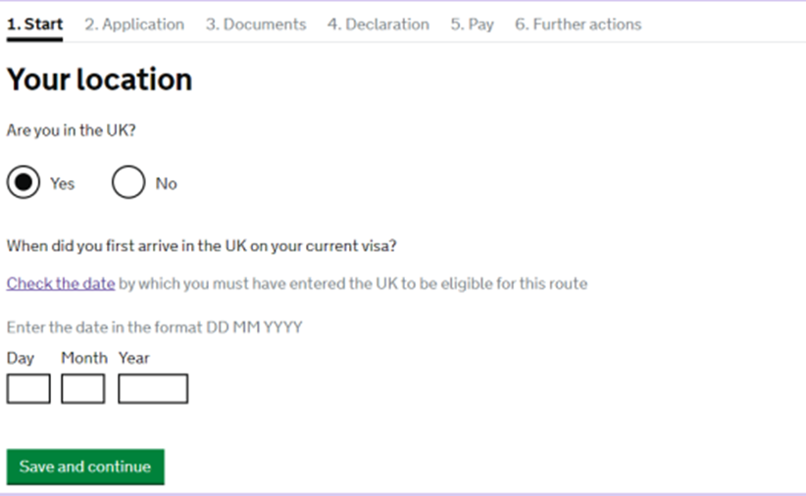
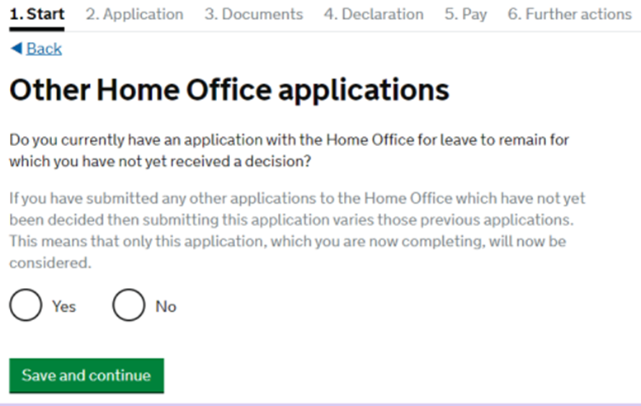
Completing the Application
You must be in the UK to apply
Answer as appropriate -if you have another visa application pending it will be varied by making this application

Slide 13
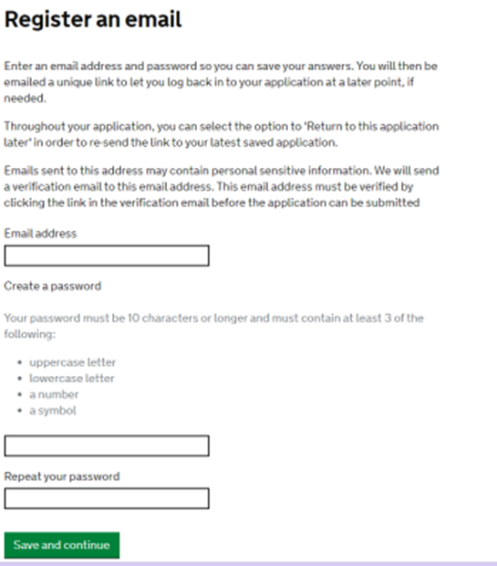
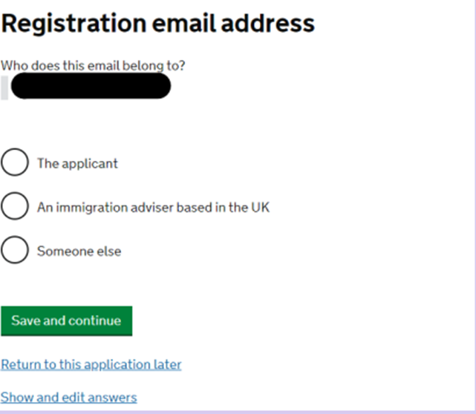
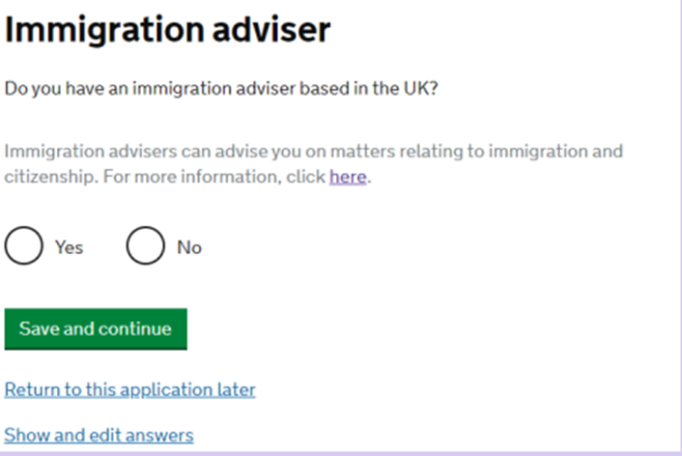
Application
Use a personal email address, as your University email address will expire after graduation
Answer as appropriate
Say no if completing application by yourself. Using this guide does not mean you have an immigration adviser

Slide 14
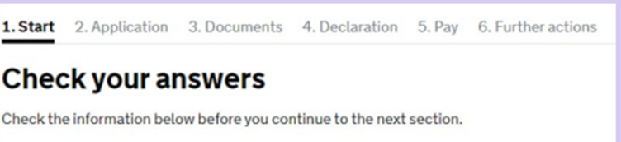
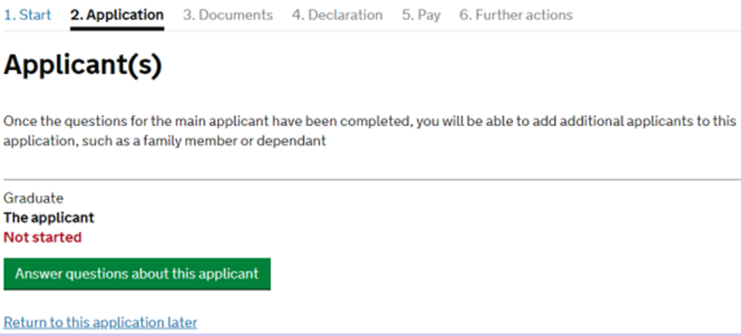
Application
You will need to complete all sections
You do not have to complete all sections at the same time
You can change and amend the form until you sign the declaration
The date of application is the date you pay and submit the application, this should be before your student visa expiry date

Slide 15
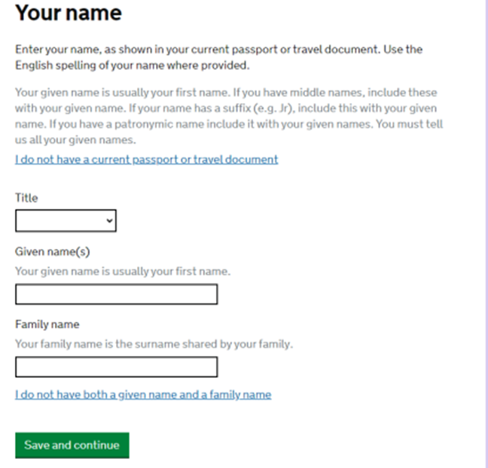
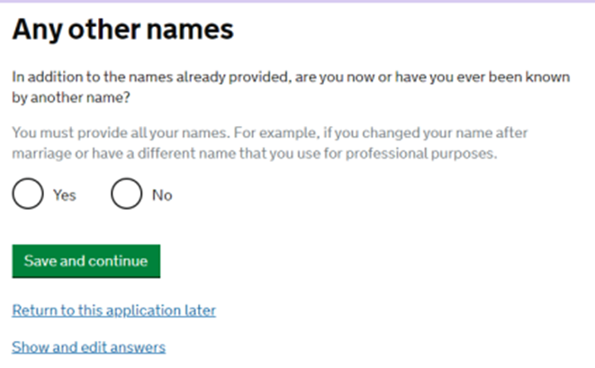
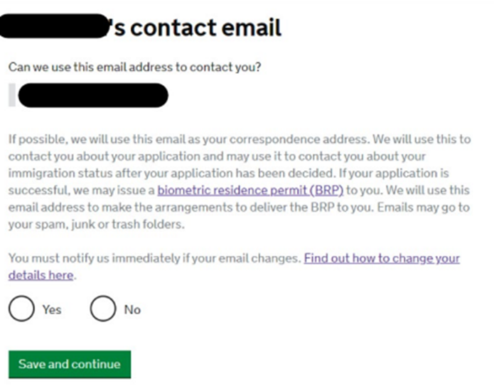
Answer as appropriate

Slide 16
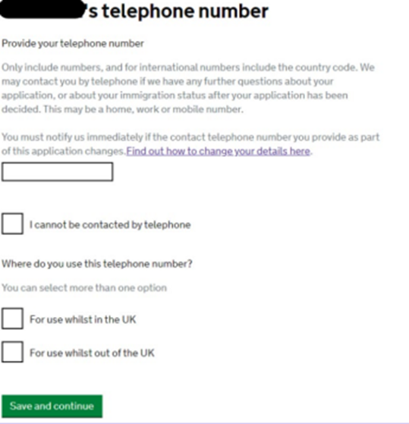
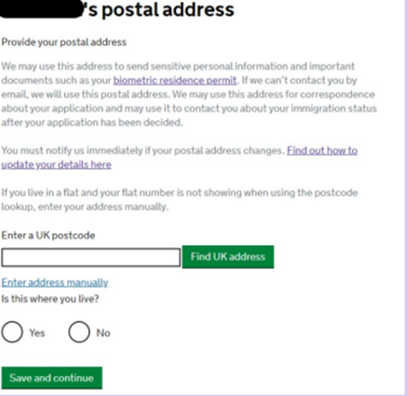
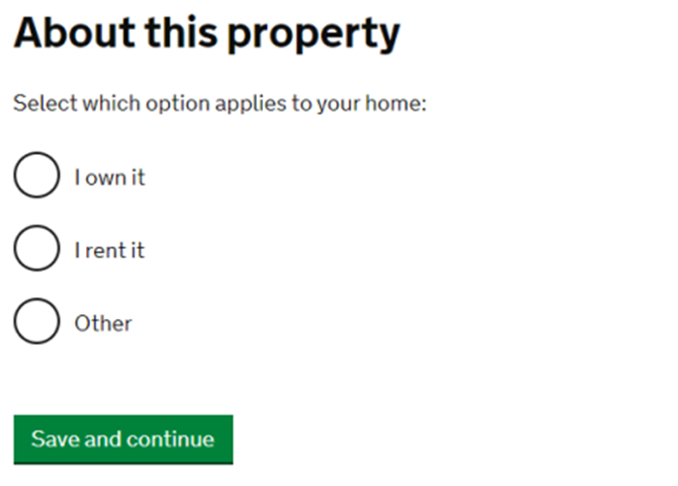
Answer as appropriate

Slide 17
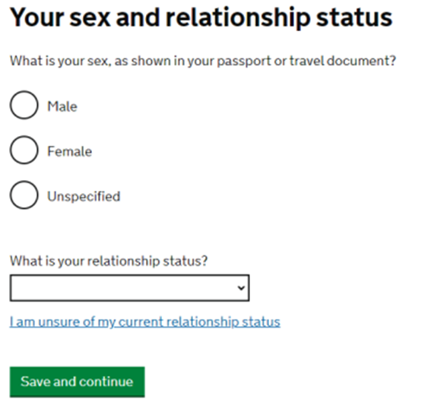
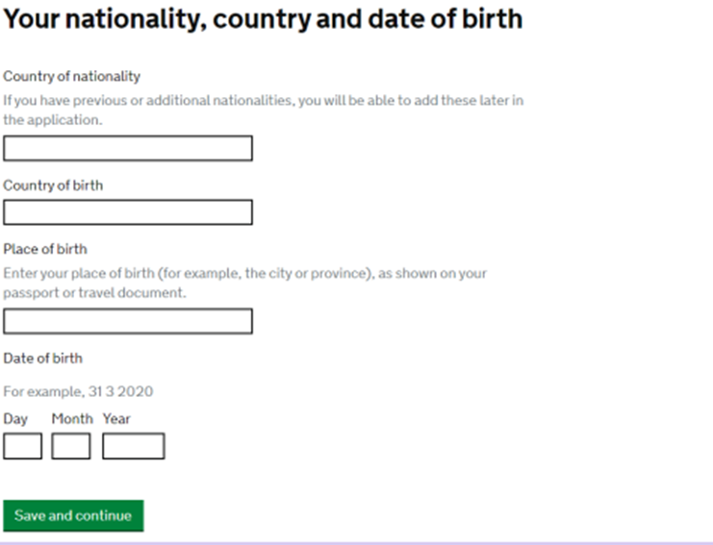
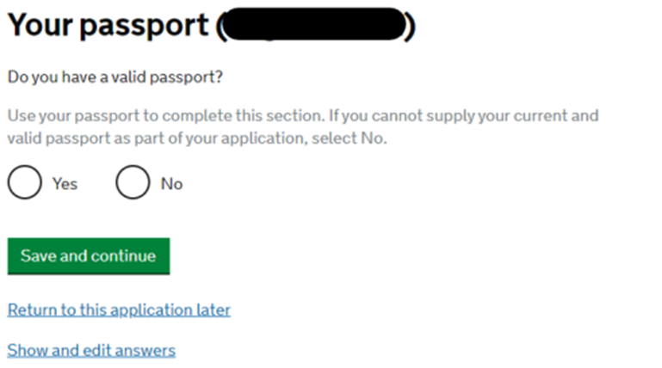
Ensure details entered match information in your passport. If a dual national use nationality listed in passport you are using for this application
Answer as appropriate
You must have passport which is valid (not expired) at point of application

Slide 18
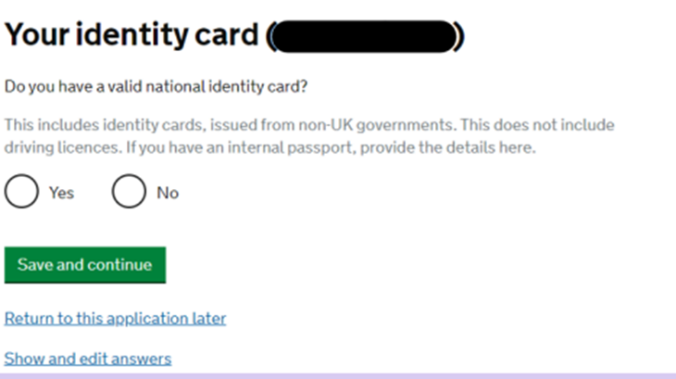
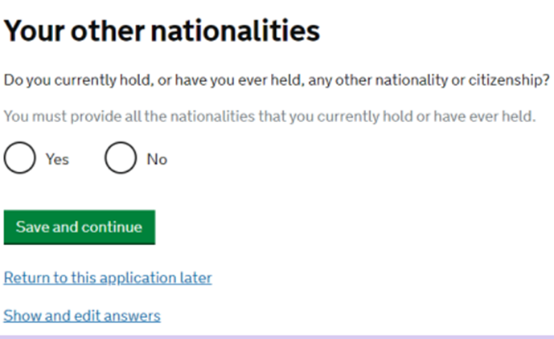
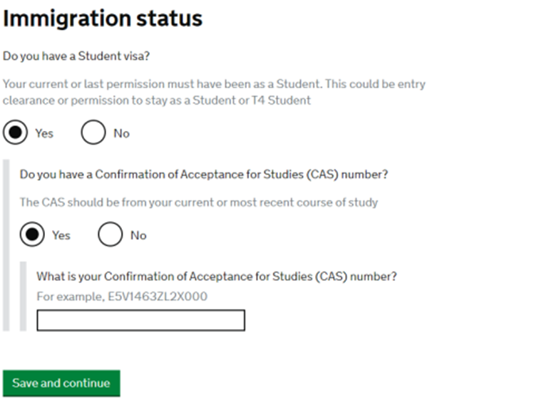
This is your home country’s ID card if you have one, this is not your old BRP
Answer as appropriate
We will have sent you your last CAS number in email confirming eligibility, this CAS used for last student visa

Slide 19
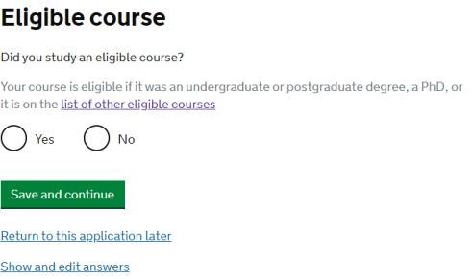
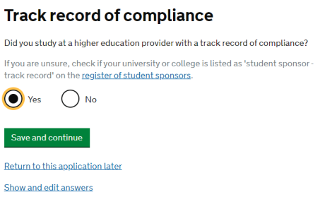
Answer YES . The U of S is a HEI with a track record of compliance
This should be YES. We will only send you eligibility email if you are on an eligible course.Please note if you complete with lower award you may not be eligible

Slide 20
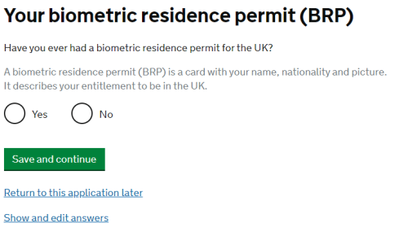
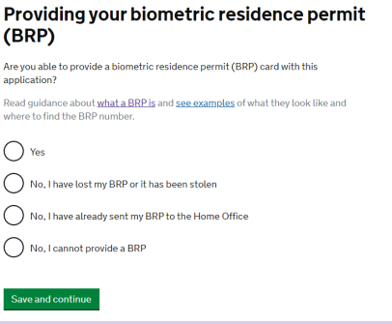
Answer as appropriate
Answer as appropriate

Slide 21
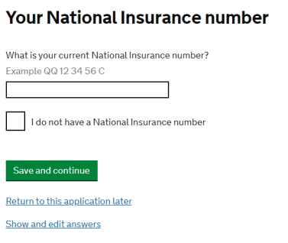
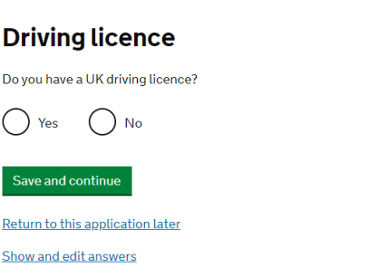
Provide this if you have one, you will need an NI number if you want to work in the UK
Answer as appropriate

Slide 22
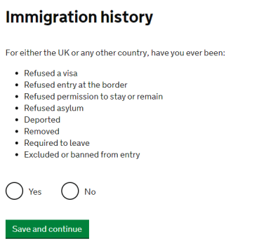
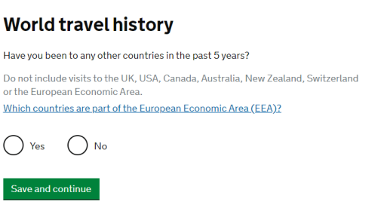
Please provide as accurate information as possible. If you have travelled to any of the listed countries, you will then be prompted to provide more details about your travels.
You must answer this question truthfully. If the answer is ‘yes’, you will be prompted to provide more details. If this applies to you, please provide comprehensive details of what happened.

Slide 23
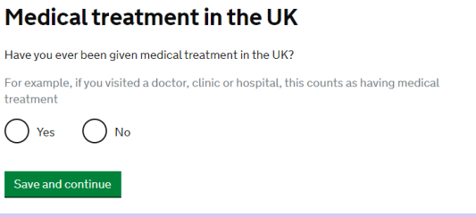
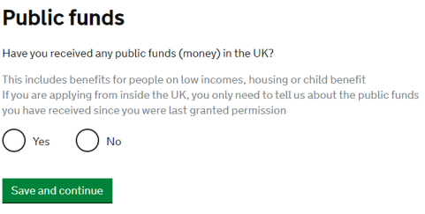
If you have received medical treatment in the UK, you will be prompted to provide further details. Be as accurate as you can and if you were ever charged for medical treatment provide evidence of payment. If you held student visa previously you will have paid Immigration Healthcare Surcharge and so will have been entitled to free NHS healthcare.
Answer as appropriate, you should not have claimed public funds whilst on a student visa

Slide 24
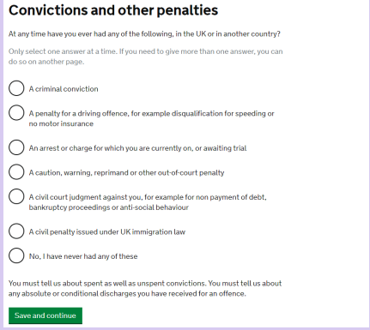
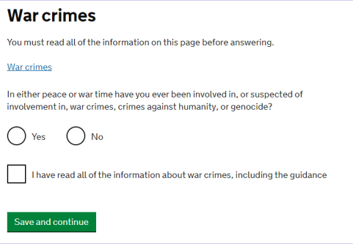
Answer truthfully. Minor offences e.g traffic fines should not affect your application but more serious offences could, seek further advice if needed
Answer truthfully

Slide 25
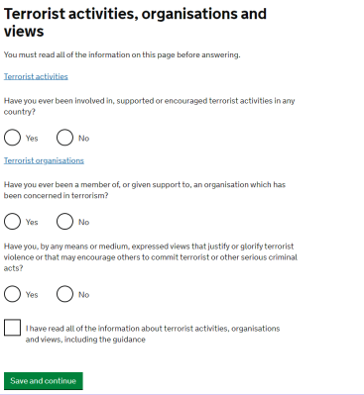
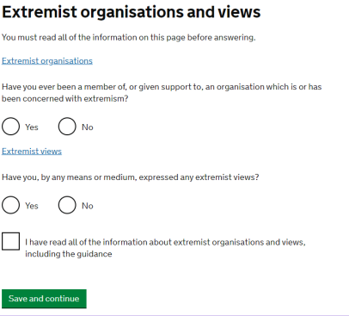
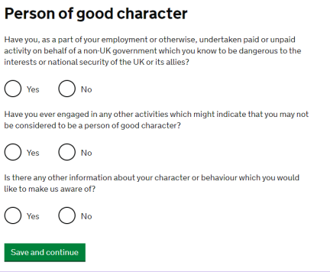
You must answer these questions truthfully and confirm you have read the additional information provided.

Slide 26
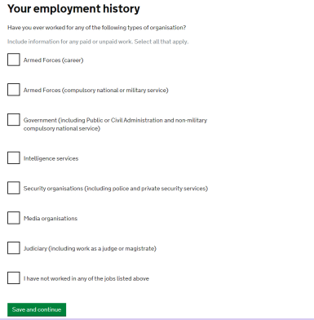

If your official sponsorship covers both fees and living costs then select YES. If you select yes you will be required to provide a letter of consent from your sponsor approving your application - seek further advice if required
If you have worked for any of the organisations listed here, you will need to select the relevant option. You will then be prompted to provide more details about your employment there.

Slide 27

You have now completed all of the questions
Check your answers carefully before you proceed to next stage

Slide 28


Documents & Declaration
You can add details of your dependant(s) here but they must complete a separate application form see https://www.gov.uk/graduate-visa/your-partner-and-children
You will need to tick all the boxes and provide all of the documents listed on this page

Slide 29


Declaration
Read carefully. You cannot edit your answers after signing declaration
Please read through before you tick the box

Slide 30

Pay Immigration Healthcare Surcharge & Visa Fee
Click Go To IHS and you will be redirected to the payment website
After payment you will get email confirmation of payment which you should retain for your records
You be directed back to your visa application and then asked to pay the visa fee

Slide 31
Pay for Application & Final steps
You should receive a visa fee payment confirmation email - this means you have submitted the application, keep a copy
You will then need to upload your supporting documents
We suggest you download & keep a copy of the application form for your records
If you did not use IDV app to register your biometrics you will also need to book appointment at a TLS visa application centre. You should be directed to relevant website
If using a visa application centre, you must also upload your supporting documents to the TLS website, and do so before you attend the biometric appointment
Standard applications can take up to 8 weeks to be processed. Priority applications may be available at extra cost if you need a quicker decision
If you make valid in time application before your Student visa expiry date, you can stay in the UK lawfully whilst the GIR application is pending, even if your current visa expires and you will will have section 3c leave which extends your student visa conditions such as the right to work or rent
Do not travel outside of the UK or common travel area whilst the application is being processed, as this will withdraw the application !

Slide 32
Good Luck with your application !

